Slide 1


Protect Your Real Estate Empire: LLCs, Holding Companies & Asset Protection for Property Investors
Jonathan Feniak, MBA, Esq., Lead Attorney

Slide 2






1
2
3
1
2
3
What to Expect
Why real estate investors NEED LLCs
The 4 protection structures that scale with your portfolio
Financing
Common Mistakes & Protecting Your Privacy
Tax Strategies
Q&A
session
4
5
6
4
5
6

Slide 3

LLC Attorney is a business formation company, not a law firm.
We have helped over 80,000 entrepreneurs launch new businesses and stay compliant through our streamlined formation services, backed by our team of experienced attorneys who provide guidance and support throughout your business journey.
Our focus is on making business formation fast, friendly, and accessible—without the traditional law firm experience or pricing structure.

Slide 4




Where are you in your real estate journey?
Just getting started (0-1 properties)
Building my portfolio (2-5 properties)
Experienced investor (6+ properties)
Property management business
Real estate professional/agent
Answers will remain private

Slide 5
Why Real Estate Investors Need LLCs

Slide 6






Real estate investors face unique risks
Tenant lawsuits and injuries
Permitting and licensing actions
Personal liability exposure via veil piercing
Privacy concerns from public records
Personal claims enforced against real estate

Slide 7


Personal Ownership
=
Personal Liability
01
Your personal home at risk from rental property claims
02
Personal bank accounts can be seized
03
Future earnings garnished
04
No privacy protection
05
Maximum tax burden
Notes:
Veil Piercing occurs when an owner of a business is held liable for the business liabilities.
Varies by state, but generally business is an “alter ego” of the owner and used to perpetrate a fraud or defeat a rightful claim.
Can you establish you were solely acting as a representative of the company?
Signing as representative of business entity, not personally

Slide 8
The 4 Real Estate Investment Structures

Slide 9

Structure 1: No LLC
Pros:
Simple
Insurance can mitigate risk
Lower administrative cost
Easier financing
Cons:
Zero asset protection
Personal liability for everything
No privacy protection
Your home and savings at risk
Notes:
LLC Can either be Member Managed or Manager Managed. The simplest is Member Managed. One level of ownership and control.
Manager Managed divided ownership from control. Allows for those with more expertise to run the company, with the oversight and input of the owners.
Corporations: Shareholders, Board of Directors, Officers. Three levels of ownership and control.
The more level there are, the better your record keeping must be.
Surprisingly, the tax options for LLCs and Corporations are the same. That is because a business entity is a creature of STATE law and tax classification is set by Federal Law.
We will talk about this more later in the Webinar.

Slide 10
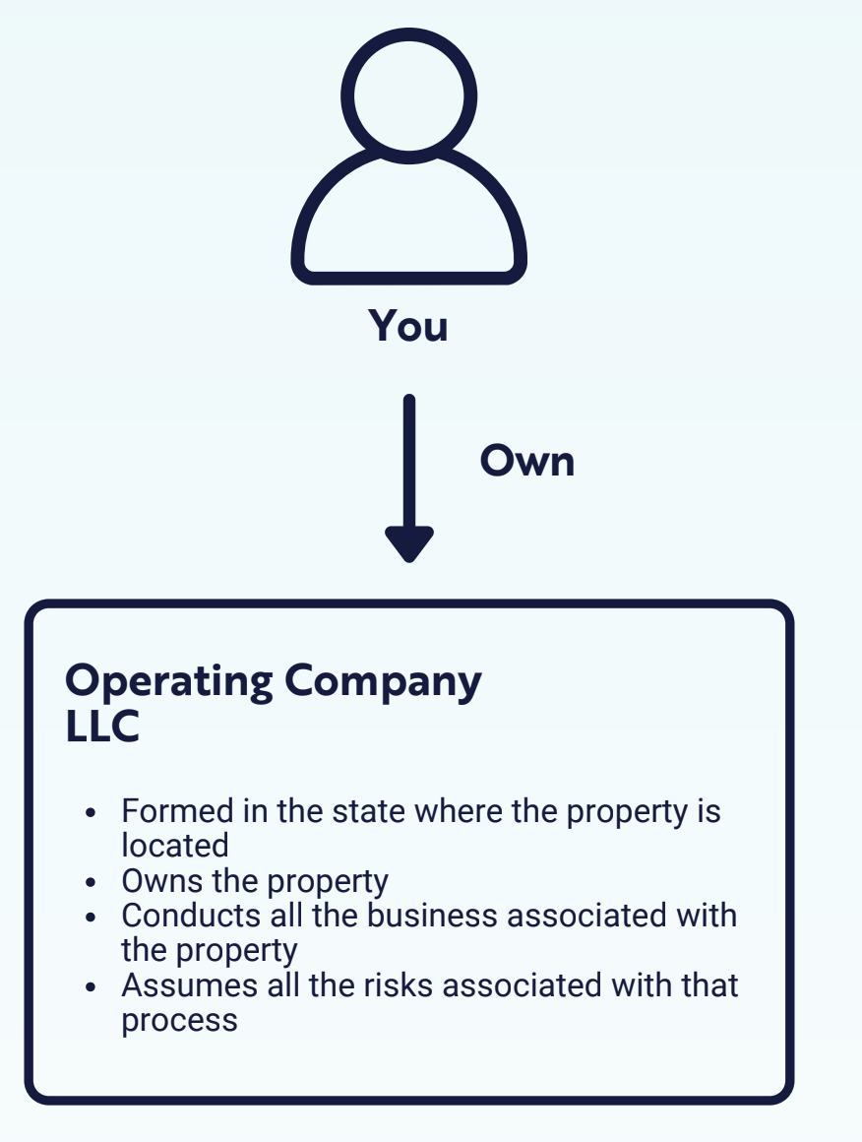
Structure 2: Single LLC
Best for: 1-3 properties in same state
Pros:
Low administrative burden
Single tax return
Relatively simple
Cons:
All properties at risk if one faces litigation
Limited privacy protection
If state has weak laws, veil piercing may occur
Notes:
LLC Can either be Member Managed or Manager Managed. The simplest is Member Managed. One level of ownership and control.
Manager Managed divided ownership from control. Allows for those with more expertise to run the company, with the oversight and input of the owners.
Corporations: Shareholders, Board of Directors, Officers. Three levels of ownership and control.
The more level there are, the better your record keeping must be.
Surprisingly, the tax options for LLCs and Corporations are the same. That is because a business entity is a creature of STATE law and tax classification is set by Federal Law.
We will talk about this more later in the Webinar.

Slide 11
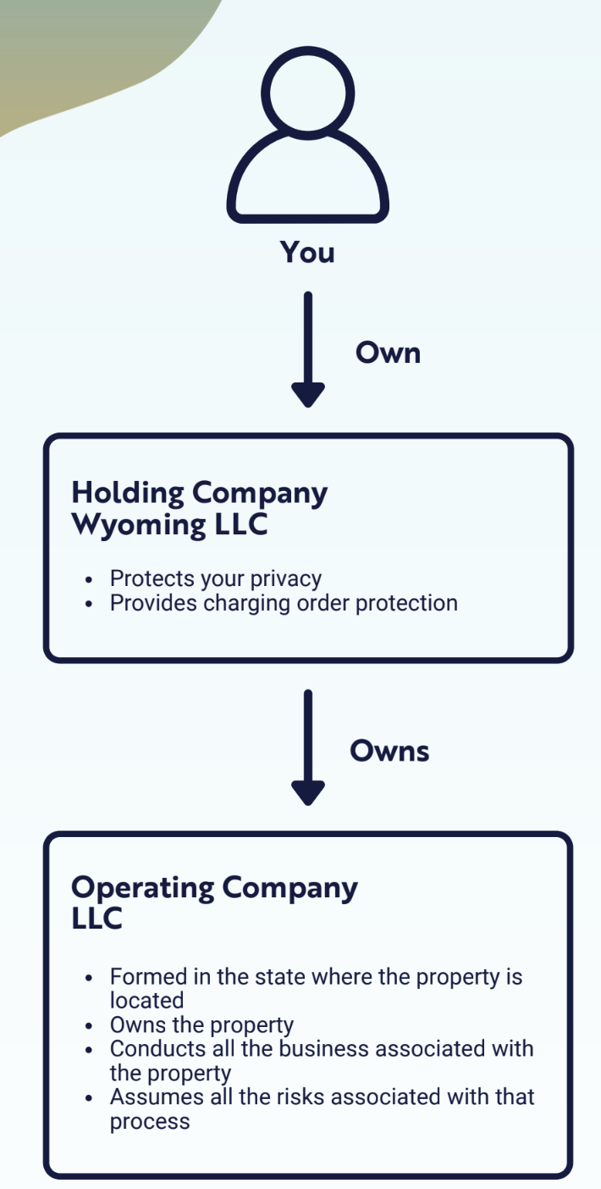
Structure 3: Wyoming Holding Company
Best for: Multiple properties or multi-state investing
Pros:
Double layer of protection
Enhanced privacy through Wyoming
Properties isolated from each other
Superior charging order protection
Reduce tax reporting expense
Cons:
Increased administrative burden
Multiple bank accounts required
Notes:
LLC Can either be Member Managed or Manager Managed. The simplest is Member Managed. One level of ownership and control.
Manager Managed divided ownership from control. Allows for those with more expertise to run the company, with the oversight and input of the owners.
Corporations: Shareholders, Board of Directors, Officers. Three levels of ownership and control.
The more level there are, the better your record keeping must be.
Surprisingly, the tax options for LLCs and Corporations are the same. That is because a business entity is a creature of STATE law and tax classification is set by Federal Law.
We will talk about this more later in the Webinar.

Slide 12
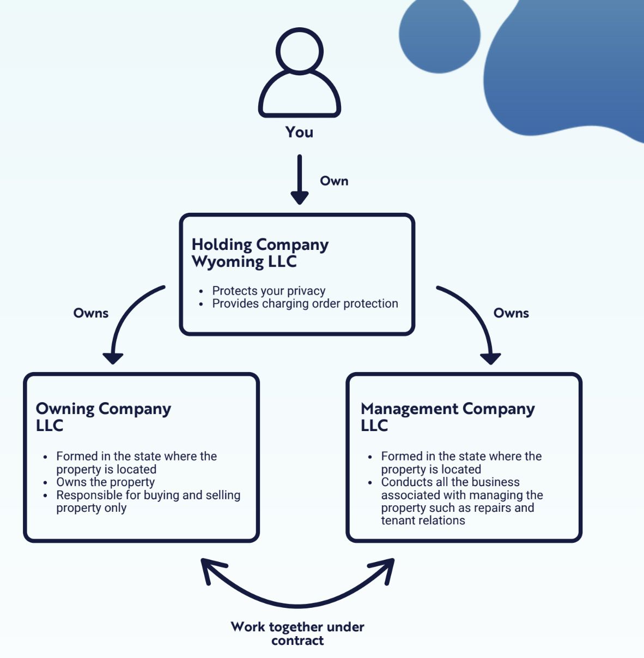
Structure 4: Full Separation
Best for: Large portfolios and high liability exposure
Pros:
Maximum asset protection
Complete separation of assets from operations
Optimal tax planning opportunities
Highest privacy level
Cons:
High administrative burden
Requires diligent compliance
Notes:
LLC Can either be Member Managed or Manager Managed. The simplest is Member Managed. One level of ownership and control.
Manager Managed divided ownership from control. Allows for those with more expertise to run the company, with the oversight and input of the owners.
Corporations: Shareholders, Board of Directors, Officers. Three levels of ownership and control.
The more level there are, the better your record keeping must be.
Surprisingly, the tax options for LLCs and Corporations are the same. That is because a business entity is a creature of STATE law and tax classification is set by Federal Law.
We will talk about this more later in the Webinar.

Slide 13
What About Land Trusts?

Slide 14

Why Not Land Trusts? The Alternative Everyone Talks About
What is a Land Trust?
Trust specifically designed to hold real estate
Provides some privacy benefits
Often promoted by real estate "gurus"
Sounds good... so why not use them?
Notes:
LLC Can either be Member Managed or Manager Managed. The simplest is Member Managed. One level of ownership and control.
Manager Managed divided ownership from control. Allows for those with more expertise to run the company, with the oversight and input of the owners.
Corporations: Shareholders, Board of Directors, Officers. Three levels of ownership and control.
The more level there are, the better your record keeping must be.
Surprisingly, the tax options for LLCs and Corporations are the same. That is because a business entity is a creature of STATE law and tax classification is set by Federal Law.
We will talk about this more later in the Webinar.

Slide 15
The Issue with Land Trusts
Land Trust Advantages
Critical Weaknesses
Basic privacy (trustee name on deed)
Substitute for estate planning Revocable Living Trust
No ongoing state fees
May avoid transfer taxes (beware!)
Questionable asset protection (Varies by state)
Not private if you're the trustee
Nominee trustee adds risk
LLC trustee adds costs
Difficult to obtain financing
Reduced tax flexibility
Notes:
LLC Can either be Member Managed or Manager Managed. The simplest is Member Managed. One level of ownership and control.
Manager Managed divided ownership from control. Allows for those with more expertise to run the company, with the oversight and input of the owners.
Corporations: Shareholders, Board of Directors, Officers. Three levels of ownership and control.
The more level there are, the better your record keeping must be.
Surprisingly, the tax options for LLCs and Corporations are the same. That is because a business entity is a creature of STATE law and tax classification is set by Federal Law.
We will talk about this more later in the Webinar.

Slide 16
Land Trusts vs. LLCs
LLCs Provide
Land Trusts Provide
True asset protection with proven corporate veil
Charging order protection
Tax flexibility and deductions
Business legitimacy
Scalable structure as portfolio grows
Complicated privacy options
Questionable asset protection
Reduced financing options
Limited utility for investors
Winner: LLC every time for serious real estate investors
Notes:
LLC Can either be Member Managed or Manager Managed. The simplest is Member Managed. One level of ownership and control.
Manager Managed divided ownership from control. Allows for those with more expertise to run the company, with the oversight and input of the owners.
Corporations: Shareholders, Board of Directors, Officers. Three levels of ownership and control.
The more level there are, the better your record keeping must be.
Surprisingly, the tax options for LLCs and Corporations are the same. That is because a business entity is a creature of STATE law and tax classification is set by Federal Law.
We will talk about this more later in the Webinar.

Slide 17
Financing

Slide 18
Understanding Your Options
Different loan types have different LLC rules:
Conforming Mortgages (Fannie/Freddie)
Commercial Loans
DSCR Loans (Debt Service Coverage Ratio)
Cash Purchases
Private Lending
Each affects your LLC strategy differently
Notes:
LLC Can either be Member Managed or Manager Managed. The simplest is Member Managed. One level of ownership and control.
Manager Managed divided ownership from control. Allows for those with more expertise to run the company, with the oversight and input of the owners.
Corporations: Shareholders, Board of Directors, Officers. Three levels of ownership and control.
The more level there are, the better your record keeping must be.
Surprisingly, the tax options for LLCs and Corporations are the same. That is because a business entity is a creature of STATE law and tax classification is set by Federal Law.
We will talk about this more later in the Webinar.

Slide 19
Conforming Mortgages & LLCs
What are Conforming Loans?
LLC Challenges:
Follow Fannie Mae/Freddie Mac guidelines
Loan limits: $766,550 (most areas) in 2025
1-4 unit residential properties only
Personal income qualification required
Most require personal guarantee
May trigger due-on-sale clause
Limited to 10 financed properties total
Higher rates for investment properties
Best For: Small portfolios, personal name purchases then transfer
Notes:
LLC Can either be Member Managed or Manager Managed. The simplest is Member Managed. One level of ownership and control.
Manager Managed divided ownership from control. Allows for those with more expertise to run the company, with the oversight and input of the owners.
Corporations: Shareholders, Board of Directors, Officers. Three levels of ownership and control.
The more level there are, the better your record keeping must be.
Surprisingly, the tax options for LLCs and Corporations are the same. That is because a business entity is a creature of STATE law and tax classification is set by Federal Law.
We will talk about this more later in the Webinar.

Slide 20
Commercial Loans
When You Need Commercial Loans:
LLC Benefits:
Can close directly in LLC name
No personal residence restrictions
Higher loan amounts available
Portfolio lending options
Properties with 5+ units
Purchase price above conforming limits
Multiple properties in one loan (blanket loan)
Non-residential real estate
Trade-offs: Higher rates, shorter terms (5-10 years), balloon payments
Notes:
LLC Can either be Member Managed or Manager Managed. The simplest is Member Managed. One level of ownership and control.
Manager Managed divided ownership from control. Allows for those with more expertise to run the company, with the oversight and input of the owners.
Corporations: Shareholders, Board of Directors, Officers. Three levels of ownership and control.
The more level there are, the better your record keeping must be.
Surprisingly, the tax options for LLCs and Corporations are the same. That is because a business entity is a creature of STATE law and tax classification is set by Federal Law.
We will talk about this more later in the Webinar.

Slide 21
DSCR Loans
What are DSCR Loans?
Advantages:
Can close directly in LLC name
No limit on number of properties
No personal income verification
Perfect for property management LLCs
Qualification based on property income, not personal income
No W-2s, pay stubs, or tax returns required
Available for investment properties only
Trade-offs: Higher rates, higher down payments, math can be challenging
Notes:
LLC Can either be Member Managed or Manager Managed. The simplest is Member Managed. One level of ownership and control.
Manager Managed divided ownership from control. Allows for those with more expertise to run the company, with the oversight and input of the owners.
Corporations: Shareholders, Board of Directors, Officers. Three levels of ownership and control.
The more level there are, the better your record keeping must be.
Surprisingly, the tax options for LLCs and Corporations are the same. That is because a business entity is a creature of STATE law and tax classification is set by Federal Law.
We will talk about this more later in the Webinar.

Slide 22
Cash Purchase
Cash Purchase Benefits
Financing Strategies:
Refinance after purchase (cash-out refi)
Hard money bridge to permanent financing
Business lines of credit
1031 exchange proceeds
Close directly in LLC name - no lender restrictions
No due-on-sale clause concerns
Immediate asset protection
Stronger negotiating position
Trade-offs: No benefit from leverage, equity in property is exposed
Notes:
LLC Can either be Member Managed or Manager Managed. The simplest is Member Managed. One level of ownership and control.
Manager Managed divided ownership from control. Allows for those with more expertise to run the company, with the oversight and input of the owners.
Corporations: Shareholders, Board of Directors, Officers. Three levels of ownership and control.
The more level there are, the better your record keeping must be.
Surprisingly, the tax options for LLCs and Corporations are the same. That is because a business entity is a creature of STATE law and tax classification is set by Federal Law.
We will talk about this more later in the Webinar.

Slide 23
Private Lending
What is Private Lending?
Benefits:
Flexible on entity structure
Fast closing (7-14 days)
Based on deal strength, not borrower profile
Can fund renovations
Non-bank lenders (individuals, funds)
Asset-based lending (property value focus)
Short-term bridge financing
Fix-and-flip funding
Trade-offs: Higher down payments, higher interest rates, aggressive enforcement
Notes:
LLC Can either be Member Managed or Manager Managed. The simplest is Member Managed. One level of ownership and control.
Manager Managed divided ownership from control. Allows for those with more expertise to run the company, with the oversight and input of the owners.
Corporations: Shareholders, Board of Directors, Officers. Three levels of ownership and control.
The more level there are, the better your record keeping must be.
Surprisingly, the tax options for LLCs and Corporations are the same. That is because a business entity is a creature of STATE law and tax classification is set by Federal Law.
We will talk about this more later in the Webinar.

Slide 24
Matching Structure to Financing
Single-Family Rentals
Start: Personal name with conforming loans
Then: Transfer to LLC or DSCR loans
Small Multifamily (2-4 units)
Conforming loans in personal name
Transfer to LLC after closing
Large Multifamily (5+ units)
Commercial loans directly in LLC
No personal name option
Fix-and-Flip
Hard money loans in LLC name
Business lines of credit
Notes:
LLC Can either be Member Managed or Manager Managed. The simplest is Member Managed. One level of ownership and control.
Manager Managed divided ownership from control. Allows for those with more expertise to run the company, with the oversight and input of the owners.
Corporations: Shareholders, Board of Directors, Officers. Three levels of ownership and control.
The more level there are, the better your record keeping must be.
Surprisingly, the tax options for LLCs and Corporations are the same. That is because a business entity is a creature of STATE law and tax classification is set by Federal Law.
We will talk about this more later in the Webinar.

Slide 25
Due-on-Sale Clause
The Fear: "My bank will call my loan if I transfer to LLC”
What is a Due-on-Sale Clause?
Best Practices
Included in mortgage to protect lender
Garn-St. Germain Act protects transfers to trusts (but trusts don't protect you)
Most lenders focus on payment performance, not ownership changes
Rarely enforced for performing loans
LLC transfers are technically violations but practically ignored
Keep making payments on time
Don't advertise the transfer
Consider DSCR refinance for peace of mind
Ensure you understand your loan terms
Likely with VA, FHA, and private loans
Notes:
LLC Can either be Member Managed or Manager Managed. The simplest is Member Managed. One level of ownership and control.
Manager Managed divided ownership from control. Allows for those with more expertise to run the company, with the oversight and input of the owners.
Corporations: Shareholders, Board of Directors, Officers. Three levels of ownership and control.
The more level there are, the better your record keeping must be.
Surprisingly, the tax options for LLCs and Corporations are the same. That is because a business entity is a creature of STATE law and tax classification is set by Federal Law.
We will talk about this more later in the Webinar.

Slide 26
Common Costly Mistakes (and How to Fix Them)

Slide 27
Administrative Inefficiencies
Costly Mistakes That Waste Your Time & Money
Multiple partnership LLCs (unnecessary tax returns)
Real estate in S-Corp (wrong tool for the job)
Notes:
LLC Can either be Member Managed or Manager Managed. The simplest is Member Managed. One level of ownership and control.
Manager Managed divided ownership from control. Allows for those with more expertise to run the company, with the oversight and input of the owners.
Corporations: Shareholders, Board of Directors, Officers. Three levels of ownership and control.
The more level there are, the better your record keeping must be.
Surprisingly, the tax options for LLCs and Corporations are the same. That is because a business entity is a creature of STATE law and tax classification is set by Federal Law.
We will talk about this more later in the Webinar.

Slide 28
Inefficiency #1: Multiple Partnership LLCs
The Problem: Multiple LLCs taxed as partnerships = Multiple tax returns
The Fix:
Create one partnership holding company
Form disregarded entity subsidiaries
Result: One tax return for entire portfolio
Tax Savings: Significant CPA fees and complexity reduction
Notes:
LLC Can either be Member Managed or Manager Managed. The simplest is Member Managed. One level of ownership and control.
Manager Managed divided ownership from control. Allows for those with more expertise to run the company, with the oversight and input of the owners.
Corporations: Shareholders, Board of Directors, Officers. Three levels of ownership and control.
The more level there are, the better your record keeping must be.
Surprisingly, the tax options for LLCs and Corporations are the same. That is because a business entity is a creature of STATE law and tax classification is set by Federal Law.
We will talk about this more later in the Webinar.

Slide 29
Inefficiency #2: Real Estate in S-Corp
Why This Is A Bad Idea:
S-Corp income must be "reasonable salary"
Rental income isn’t earned income
Complicates property transfers and refinancing because distribution of appreciated asset is a taxable event!
Better Option: LLC with optional S-Corp election for active business income only
Notes:
LLC Can either be Member Managed or Manager Managed. The simplest is Member Managed. One level of ownership and control.
Manager Managed divided ownership from control. Allows for those with more expertise to run the company, with the oversight and input of the owners.
Corporations: Shareholders, Board of Directors, Officers. Three levels of ownership and control.
The more level there are, the better your record keeping must be.
Surprisingly, the tax options for LLCs and Corporations are the same. That is because a business entity is a creature of STATE law and tax classification is set by Federal Law.
We will talk about this more later in the Webinar.

Slide 30
Asset Protection Killers
Compliance Failures That Destroy Your Protection
Never transferring property to LLC
Commingling rental income with personal funds
Poor record keeping and documentation
No separate bank accounts
Ignoring corporate formalities
Notes:
LLC Can either be Member Managed or Manager Managed. The simplest is Member Managed. One level of ownership and control.
Manager Managed divided ownership from control. Allows for those with more expertise to run the company, with the oversight and input of the owners.
Corporations: Shareholders, Board of Directors, Officers. Three levels of ownership and control.
The more level there are, the better your record keeping must be.
Surprisingly, the tax options for LLCs and Corporations are the same. That is because a business entity is a creature of STATE law and tax classification is set by Federal Law.
We will talk about this more later in the Webinar.

Slide 31
Privacy

Slide 32
Why Wyoming for a Real Estate
Holding Company?
The Gold Standard for Privacy & Protection
No state income tax
Strongest privacy laws (no member disclosure)
Superior charging order protection
Low annual fees ($60 vs $800+ in California)
Established asset protection case law
But, general rule is to form LLC in property state
Notes:
LLC Can either be Member Managed or Manager Managed. The simplest is Member Managed. One level of ownership and control.
Manager Managed divided ownership from control. Allows for those with more expertise to run the company, with the oversight and input of the owners.
Corporations: Shareholders, Board of Directors, Officers. Three levels of ownership and control.
The more level there are, the better your record keeping must be.
Surprisingly, the tax options for LLCs and Corporations are the same. That is because a business entity is a creature of STATE law and tax classification is set by Federal Law.
We will talk about this more later in the Webinar.

Slide 33
Privacy Protection Strategies
Protecting Your Information from Public View
Use nominee managers when allowed
Wyoming Holding Company LLCs for privacy
Registered agent services
Separate mailing addresses
Limit public record exposure
Notes:
LLC Can either be Member Managed or Manager Managed. The simplest is Member Managed. One level of ownership and control.
Manager Managed divided ownership from control. Allows for those with more expertise to run the company, with the oversight and input of the owners.
Corporations: Shareholders, Board of Directors, Officers. Three levels of ownership and control.
The more level there are, the better your record keeping must be.
Surprisingly, the tax options for LLCs and Corporations are the same. That is because a business entity is a creature of STATE law and tax classification is set by Federal Law.
We will talk about this more later in the Webinar.

Slide 34
Taxes

Slide 35
Tax Strategies for Real Estate
Maximizing Your Profits
Default LLC Taxation
Advanced Strategies
Cost segregation studies
1031 exchanges through LLCs
Professional status benefits
Pass-through to personal return
No entity-level tax
Schedule E for rental income
Notes:
LLC Can either be Member Managed or Manager Managed. The simplest is Member Managed. One level of ownership and control.
Manager Managed divided ownership from control. Allows for those with more expertise to run the company, with the oversight and input of the owners.
Corporations: Shareholders, Board of Directors, Officers. Three levels of ownership and control.
The more level there are, the better your record keeping must be.
Surprisingly, the tax options for LLCs and Corporations are the same. That is because a business entity is a creature of STATE law and tax classification is set by Federal Law.
We will talk about this more later in the Webinar.

Slide 36
When S-Corp Election Makes Sense
For Active Real Estate Professionals
Consider S-Corp Election When:
Active property management
Real estate development
Fix and flip operations
Significant earned income component
Savings: FICA taxes on distribution portion
Notes:
LLC Can either be Member Managed or Manager Managed. The simplest is Member Managed. One level of ownership and control.
Manager Managed divided ownership from control. Allows for those with more expertise to run the company, with the oversight and input of the owners.
Corporations: Shareholders, Board of Directors, Officers. Three levels of ownership and control.
The more level there are, the better your record keeping must be.
Surprisingly, the tax options for LLCs and Corporations are the same. That is because a business entity is a creature of STATE law and tax classification is set by Federal Law.
We will talk about this more later in the Webinar.

Slide 37
After learning about LLC formation today, my next step will be:
Form my LLC immediately (within the next 48 hours)
Form my LLC within the next week
Review my specific business needs with an expert
Still undecided - need more information
Already formed my LLC - attending for additional education only
Next Steps?
Answers will remain private

Slide 38

How We Can Help
LLC formation
Registered agent
Compliance Tools

Slide 39
How We’re Different
24 Hour Filing
No Extra Charge for Privacy
No Hidden Fees

Slide 40

Our Pricing
Starting at $49 + State Fees
(One time fee)
Starting at $14.99/Month

Slide 41
After learning about real estate LLCs today, what are your next steps?
Form my first real estate LLC immediately
Set up Wyoming holding company structure
Fix my existing LLC mistakes
Review my current structure with expert
Still need more information
Already optimized - here for education
Answers will remain private

Slide 42

50% off with code LEARN650
Until Wednesday, July 4th

