Slide 1
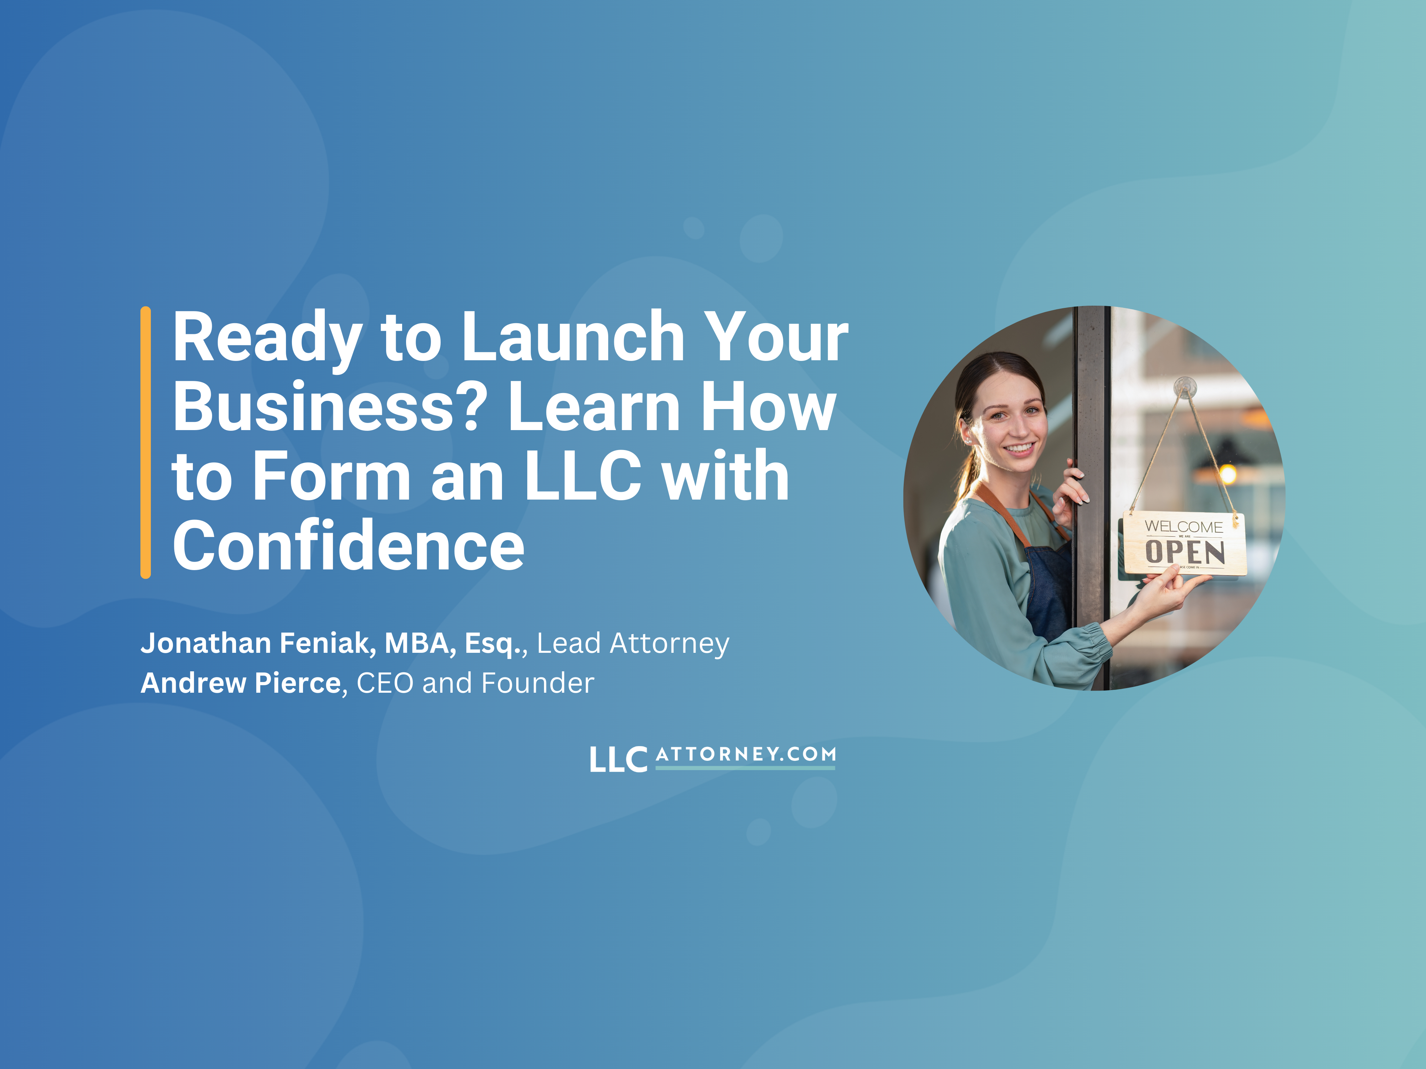


Ready to Launch Your
Business? Learn How to
Form an LLC with Confidence
Jonathan Feniak, MBA, Esq., Lead Attorney
Andrew Pierce, CEO and Founder

Slide 2






1
2
3
1
2
3
What to Expect
Introduction to LLCs and Corporations
Key benefits of
forming a legal entity
Choosing the right entity type for your business
Anonymous LLCs and protecting your privacy
Compliance requirements for liability protection and tax benefits
Q&A
session
4
5
6
4
5
6

Slide 3



Key Benefits of
Forming a Legal Entity

Slide 4






Why Form a Legal Entity?
Protect personal assets (limited liability explained).
Establish credibility with customers, vendors, and partners.
Tax advantages and tax flexibility.
Ease of compliance and scalability for future growth.
Notes:
Liability Protection: The government wants to spur people to start businesses, But not have to risk everything to do it.
They allow you to form a business entity (LLC or Corporation) so you can LIMIT your LIABILITY to what you invest in the business.
If the business owns an asset, it is at risk. But your personal assets outside of the business are (generally) safe.
Credibility: Think about how a cat arches its back and puffs up its hair to make itself seem larger. Even if its just you, having a business entity will make you look bigger and more serious.
Tax Advantages: Reduce your audit risk, survive an audit unscathed, gain the ability to evaluate and change your tax classification.
Compliance: LLC Attorney makes it easy to start out right, stay compliant, and scale as needed.

Slide 5
Choosing the Right Entity Type for Your Business
LLC vs. Corporation

Slide 6




LLC vs. Corporation
Ownership structure
Management flexibility
Taxation options
Notes:
LLC Can either be Member Managed or Manager Managed. The simplest is Member Managed. One level of ownership and control.
Manager Managed divided ownership from control. Allows for those with more expertise to run the company, with the oversight and input of the owners.
Corporations: Shareholders, Board of Directors, Officers. Three levels of ownership and control.
The more level there are, the better your record keeping must be.
Surprisingly, the tax options for LLCs and Corporations are the same. That is because a business entity is a creature of STATE law and tax classification is set by Federal Law.
We will talk about this more later in the Webinar.

Slide 7
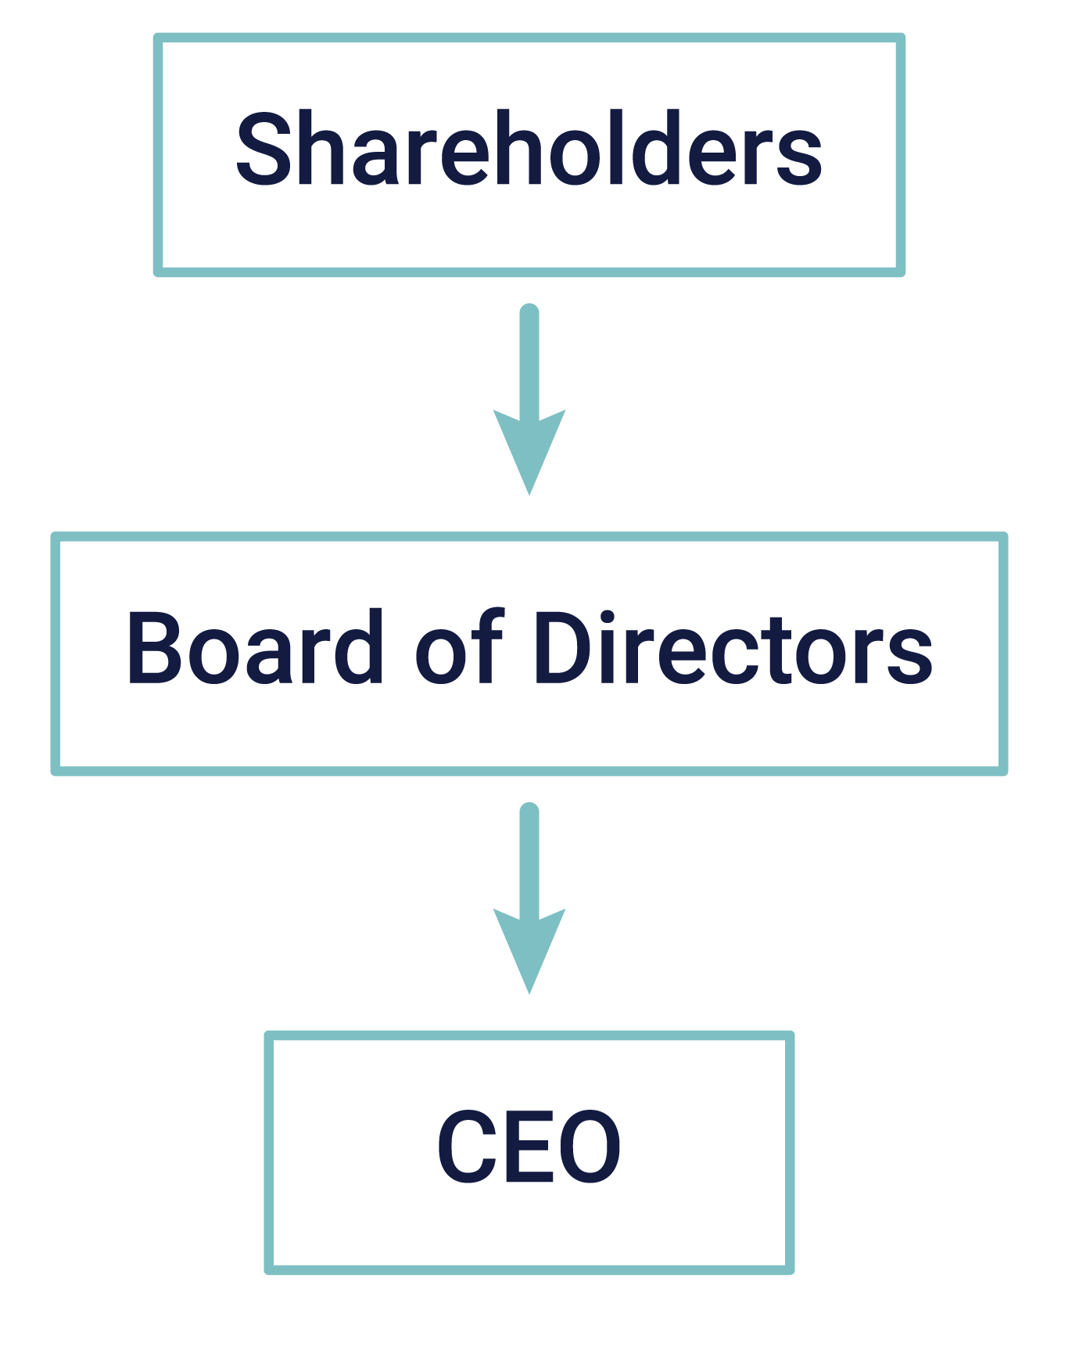

Ownership Structure & Management
LLC
Corporation
Notes:
LLC Can either be Member Managed or Manager Managed. The simplest is Member Managed. One level of ownership and control.
Manager Managed divided ownership from control. Allows for those with more expertise to run the company, with the oversight and input of the owners.
Corporations: Shareholders, Board of Directors, Officers. Three levels of ownership and control.
The more level there are, the better your record keeping must be.
Surprisingly, the tax options for LLCs and Corporations are the same. That is because a business entity is a creature of STATE law and tax classification is set by Federal Law.
We will talk about this more later in the Webinar.

Slide 8
Taxation Options
LLC
Corporation
Default disregarded entity
Can choose S-Corp or C-Corp status
Default C-Corp
Can choose S-Corp status
Notes:
LLC Can either be Member Managed or Manager Managed. The simplest is Member Managed. One level of ownership and control.
Manager Managed divided ownership from control. Allows for those with more expertise to run the company, with the oversight and input of the owners.
Corporations: Shareholders, Board of Directors, Officers. Three levels of ownership and control.
The more level there are, the better your record keeping must be.
Surprisingly, the tax options for LLCs and Corporations are the same. That is because a business entity is a creature of STATE law and tax classification is set by Federal Law.
We will talk about this more later in the Webinar.

Slide 9

LLC vs. Corporation
Corporation
LLC
Startup seeking to attract venture capital funding
Business aiming to go public in the near future
Small Business or Side Hustle
Real Estate Investment
Family-Owned Business
Freelancer or Consultant
Notes:
They are not the same. How do you decide?

Slide 10




What Should You Choose?
Probably an LLC
Keep it simple now, convert later if you need
Notes:
Easy to stay compliant
More flexible
If you think you need a corporation, you are probably wrong.
The cost of getting it wrong is a loss of limited liability protection. Here’s why, if you fail to follow the rules and laws, the company could be ignored by the courts.

Slide 11
Choosing the Right State for Your Business
Notes:
This may come as a surprise to you, but you are not required to form a business entity in the state in which you live.
Sometimes your home state makes the most sense, but often it is not the best choice.

Slide 12
Do I Need to Form My Company in My Home State?
Storing inventory or owning property in the state.
Having a physical location, employees, or significant business activity in a state.
Generating a certain level of revenue in the state.
Are you “Doing Business” in the state?
Notes:
What constitutes “doing business” in a state?
States set up these laws to make it easy for someone harmed by a business to sue the business.
Most states don’t tell you the definition. The laws typically list what DOES NOT constitute doing business.
Some examples: Interstate Commerce, Carrying on internal corporate affairs, soliciting orders by mail or internet- Not doing business
If you are doing one of the things listed here, form the business in your home state, if not, chose one of the big 3: Delaware, Nevada, or Wyoming.

Slide 13




Delaware
Pro-business legal environment.
Preferred by large corporations due to its Court of Chancery for business disputes.
Drawbacks
Annual franchise tax can be costly.
Lack of Privacy.
Notes:
Small businesses should not be formed in Delaware. Even if you are eventually going to go the “founder” route and solicit investor,
Better to star in Nevada or Wyoming and then Move the company, Domestication/Continuance when you are ready.

Slide 14



Nevada
No state income tax or corporate tax.
Privacy-friendly laws.
Drawback
Higher initial and ongoing filing fees.
Notes:
Nevada is a good choice. Nevada and Wyoming have been competing in an arms race to create the highest levels of asset protection and they are equal in many ways.
Costs are the biggest drawback.

Slide 15



Wyoming
No state income tax.
Low filing and annual fees.
Strong privacy protections (e.g., no public disclosure of LLC members).
Notes:
I am licensed in Wyoming, so I am a bit biased, but I believe you really only have 3 choices:
Home state if required.
Delaware if seeking institutional investors.
Wyoming for everyone else.

Slide 16

Anonymous LLCs and Protecting Your Privacy

Slide 17

1
2
3
1
2
3
Someone May Try To Figure Out
Where You Live And What You Own
Privacy vs.
Anonymity
Reducing your attack surfaces
You can’t unring the bell
Notes:
This part is scary, but with a successful business and wealth can come danger.
We’re going to break this topic down into three parts.
Your business may require you to be associated with it. Licensed professionals, relationship businesses, etc. That’s ok to associate yourself with that business, but you don’t need to connect yourself to your investment properties, passive investments, etc.

Slide 18


Privacy vs. Anonymity
Anonymity is a thing of the past
Privacy is achievable
Bearer Bonds
Bearer Shares
Bitcoin and Crypto
Who has your information?
Who respects your privacy?
Notes:
Bearer Bonds All bearer bonds issued by the US Treasury had matured as of May 2016, with approximately $87 million yet to be redeemed as of March 2020.[6]
Panama stands unique in still permitting the issuance of both bearer shares and registered shares – a flexibility that bolsters its appeal as a destination for international business ventures. HOWEVER, realties of the business world, make using them almost impossible.
Bitcoin and Crypto - Off-ramps and on-ramps
Privacy – Control your information. Business Address, Mailing Address.
Home address on my Driver’s license, but that is just about it!
Your information will be sold to the highest bidder.
Info you give to a bank, the IRS, business partners, is not an issue.

Slide 19

Reducing your attack surfaces
Can’t hire a security detail (yet!)
Limiting disclosure
Secretary of State Records
Property Records
Nominees
Notes:
Before you provide your personal information, pause,
Read the fine print.
If you form your company yourself, your name will be listed as the organizer
If you serve as your own Registered Agent, your home address will be listed. Not worth the risk.
Keeping your name our of real estate records, can be difficult depending on the type of financing you are obtaining. Commercial loans, no problem. Conforming mortgages, impossible.
Hire someone to sign for you! Like an attorney!

Slide 20
1
2
3
1
2
3
You Can’t Un-Ring the Bell
Once your information is disclosed, it’s out there
Misinformation
Disinformation
Rebuilding
4
5
6
4
5
6
Notes:
misinformation (destroying all the data known about you) - disavow what is out there
disinformation (creating fake trails)
Rebuild - Clean slate
I love spy movies. Jason Bourn when his home or apartment is discovered, “he’s blown” and he walks away!
Several times a month, someone didn’t think privacy was important, so their name is in the SOS records. They want to remove it. You can’t
Restart the business with a new name, transfer the assets to the new business, start over and don’t make the same mistakes.

Slide 21
Compliance is Key

Slide 22

Creating a Stronger Veil
01
Avoiding “veil piercing”
02
Creating a clear distinction between personal and business activity
03
Avoid commingling assets
04
Avoid “Living out” of the business
05
Signing Contracts
Company Name
By: Jonathan N. Feniak
Title: Manager
Notes:
Veil Piercing occurs when an owner of a business is held liable for the business liabilities.
Varies by state, but generally business is an “alter ego” of the owner and used to perpetrate a fraud or defeat a rightful claim.
Can you establish you were solely acting as a representative of the company?
Signing as representative of business entity, not personally

Slide 23
Legal Compliance
Appoint a registered agent
Maintain business records
File annual reports
Notes:
The little things matter. Liability protection does not magically appear when you form your company. To deliver on the promise of an LLC or Corporation, you have to maintain compliance.
RA – No Default judgements
Operating Agreement – Rules of the company – FOLLOW THEM
Staying in good standing
Meeting minutes – Most cases, not legally required, but easy and inexpensive way to fortify your LLC.
Single Member LLCs are thought to have weaker liability protection, because of the number of successful veil piercing cases. The piercing happens because the owner cuts corners because they are not accountable to anyone else.
Hold yourself accountable

Slide 24
1
2
3
1
2
3
Business Entities –
the Limits of Protection
Helpful with these types of claims
Contract Disputes
Employee Claims
Copyright Infringement Claims
Notes:
An LLC or corporation is a great way to limit your liability
But not perfect
Most effective, if you do it right, with these kinds of liability

Slide 25

Sometimes You Can’t Separate Yourself From the Company
What’s easier than “piercing the veil”? Sue everybody!
Holding individuals personally liable for company actions
Likely when these are involved
Federal Trade Commission
Securities and Exchange Commission
State regulators
Aggressive plaintiff’s attorneys
Notes:
A Lawyer can’t shed personal liability
Respondeat Superior - Members, Managers, Employees, ICs
Was business judgment exercised?
Documentation!
Establish company policies, procedures, and guidelines.
Document company decisions.

Slide 26





Personal Asset Protection
Offshore Trusts
Charging Order Protection
Domestic Asset Protection Trusts
Protected Assets
Advance Planning
Notes:
Offshore Trust IF you do not have a net worth of 10 million or more AND could be in a situation in which you may need to flee the country, you do not need an offshore trust. There is so much lawsuit remorse here.
Domestic Asset Protection Trust: HNW with High liability. Expensive to set up and maintain. Doing it right is not a lawsuit proposition. Plan on spending $5-10k a year on maintenance.
Advance planning: Make a plan and stick with it. Once the lawsuit is filed, it is too late. Minimize excess cash in business accounts and in your name. Privacy, LLCs, more.
Protected Assets: Homestead protection (Unlimited in FL), Pensions, 401ks
Wyoming LLC Charging Order protection. Easiest thing to do. Build wealth through a WY LLC as a holding company.

Slide 27
Tax Compliance

Slide 28
1
2
3
1
2
3
Different Tyes of income
Earned Income
Unearned Income
Mixed
Notes:
Earned Income: This refers to income generated through active participation in a trade, business, or profession.
Wages and Salaries: This is the quintessential example of earned income.
Self-Employment Income: This is also earned income, as it results from active work and effort.
Unearned Income: This refers to income generated passively, without active involvement in a trade or business.
Interest Income: Passive income from investments.
Dividend Income: Passive income from investments.
Capital Gains and Losses: While some effort may go into investing, the primary income generation is passive.
Mixed
Rental Income: While managing rental properties requires some effort, the primary income is derived from the asset itself, making it primarily unearned.
Royalties: Similar to rental income, this is often considered unearned, although the intellectual property may have required effort to create initially.

Slide 29

You Will Have to Pay Taxes.
One, Two, or Three Types of Taxes May Apply
Subject to
A
Federal Income Tax
B
State income Tax
C
FICA Tax
12.4% of income up to $168,600
2.9% of income with no limit
0.9% of amount above $200,000
Notes:
Federal – All income
State – IF you live in a state with taxes, may be flat tax, may only apply to certain types of income, may be similar to federal
FICA – Only for Earned Income

Slide 30
Reducing Taxes
Deductions reduce all taxes
State Income Taxes
Take every valid business deduction…and keep meticulous records so you are “audit proof”
Move to a low tax state:
Alaska, Florida, Nevada, New Hampshire, South Dakota, Tennessee, Texas, Washington and Wyoming
Puerto Rico!
Notes:
Valid business deduction examples
Does the expense help you generate revenue
Don’t commingle company and business expenses
Company bank account and company credit card
State taxes based on Source of income and/or location of taxpayer!
Move! I moved to Puerto Rico in 2022

Slide 31

Reducing Taxes by Changing Tax Classification
Entity Type is determined at the state level
LLC
Corporation
Tax Classification based on
Default Rules OR
Federal Election
Notes:
LLC with C-Corp Tax Election
Corporation with Partnership Tax Election
LLC or Corporation with S-Corp tax election

Slide 32

Reducing Taxes with S-Corp Classification
FICA Tax
LLC or Corporation can make S-Corp tax election
All Income “passed through” to owners, but divided into
Reasonable salary - subject to state, federal, and FICA taxes
Distribution - subject to state and federal taxes
Notes:
Can result in savings if Earned Income.

Slide 33




When an S-Corp Does Make Sense
Consider When
Owner does not have significant W2 income from other sources
Majority of FICA is paid on $168,600 of ordinary income.
If a high earner and this is a side hustle, savings is limited.
Reasonable Salary is low compared to total income of business
Reasonable Salary must be paid to ALL owners
Costs of setting up payroll, registering as a foreign entity, etc, are significantly lower than tax savings
Business generates Earned Income

Slide 34
Reducing taxes With
C-Corp Classification
Federal Income Taxes
Single and Multi Member LLCs “pass through” all income to owners and owners pay taxes on all income at personal rates
LLCs can elect to be taxed as a C-Corp
C-Corps can pay salaries to owners that are taxed at personal rates and “retain earnings” that are taxed at C-Corp rates (21%)
“Retained earnings” can be reinvested in company, compounding at 21% rate, and then paid as dividends to owners at a later date
Notes:
If you are driving all/most of the profits of the business back into the business, a C-Corp may save you money.
Forty-four states levy a corporate income tax. Top rates range from a 2.5 percent flat rate in North Carolina to a 9.8 percent top marginal rate in Minnesota.
Four states—Alaska, Illinois, Minnesota, and New Jersey—levy top marginal corporate income tax rates of 9 percent or higher.
South Dakota and Wyoming are the only states that levy neither a corporate income nor gross receipts tax.
https://taxfoundation.org/data/all/state/state-corporate-income-tax-rates-brackets-2024/

Slide 35



When a C-Corp Does Make Sense
Consider When
Big profits are more than owners will spend
Owner can pay themselves to support lifestyle and leave remainder in C-Corp
Big losses in initial years will generate NOLS.
Owner is in high tax jurisdiction and does not want all income to flow to personal return.
Venture Backing - Investors want growth, not current pass-through income

Slide 36

General Rules
Initially, Choose Disregarded Entity classification or Partnership Classification, Not C-Corp or S-Corp Classification
Evaluate if the company could benefit from an S-Corp or C-Corp election at the start of every year and make the election if the math supports it.
Keep good records, make quarterly payments, file returns as required
Notes:
All too frequently, people make an S-Corp election on day one, or they think they need a state level Corporation to make an S-Corp election. You now know better.
S-Corp and C-Corp tax returns are complicated and not a DIY. Figure that into your planning.
Also, undoing an S-or C election can have nasty tax consequences.

Slide 37
How We Can Help
LLC formation
Registered agent
Compliance Tools

Slide 38
How We’re Different
24 Hour Filing
No Extra Charge for Privacy
No Hidden Fees

Slide 39

Our Pricing

Slide 40

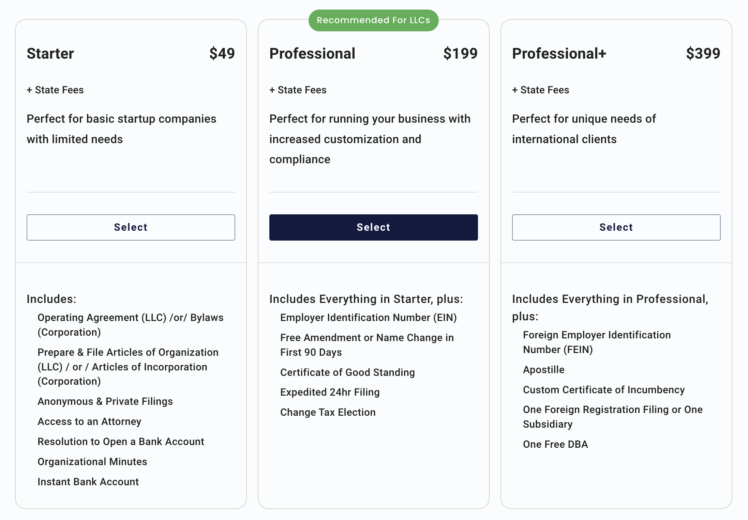
Formation Packages

Slide 41
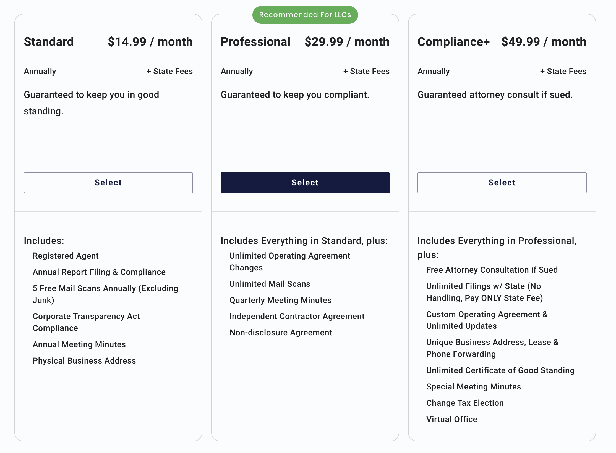
Ongoing Compliance

Slide 42
30% off with code LLCSAVE30

