Slide 1




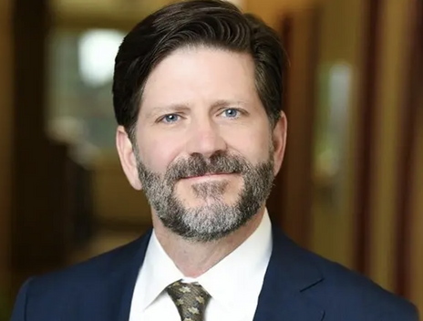
March 2025
Protect Your Assets & Maximize Tax Savings:
Simrah Ali
Account Executive, Relay
Essential LLC & Banking Strategies for Entrepreneurs
Jonathan Feniak
Lead Attorney, LLC Attorney

Slide 2

Tell us:
Where you’re calling from
What kind of business are you running ?
How long have you been running it?
Survey
GETTING TO
KNOW YOU
Notes:
What’s your business & how long have you been running it?
We work with so many different industries, professional services, salons, field service businesses, ecommerce, agencies, property managers, tech startups…. The list goes on and on!
So interesting to learn who we have on the webinar!
BANTER

Slide 3
AGENDA
01
Getting to know you
02
LLC Formation & Asset Protection
03
Corporate Veil Protection & Personal Liability
04
Banking Strategies for Business/Personal Separation
05
Tax Benefits & Business Credit Building
06
Relay deep dive (demo)
07
Q&A

Slide 4
HOUSEKEEPING
Engage, Engage, Engage! Ask the questions! Emojis are good too!
Session is being recorded and will be emailed after - so be present!
This session is going to end at 2:00 PM EDT / 11:00 AM PDT
Notes:
A few housekeeping items before we start:
First: if you have any questions, we will be answering everything at the end. But please don’t hesitate to ask them using the Q&A button at the bottom of the zoom webinar window!
Second: The session is being recorded, and you will receive the recording afterward!
And finally, one of the beautiful things about a live webinar is that it’s interactive! So, we will ask you some questions, so be prepared to answer them in the chat box!
And with that said, here’s our first question to you:

Slide 5




GETTING TO KNOW US
Founded in 2018
100% online banking
WHAT IS RELAY?
Serving business in the United States
Partnered with Thread Bank, Member FDIC
Official platform for Profit First
Notes:
We’ll dive more into the features shortly, but first: what’s Relay’s story?
We were founded in 2018 by co-founders with a long track record of working in payments, with small businesses, and with small business advisors.
We serve all of the United States.
We do not have physical branches.
And we are partnered with Thread Bank — a bank that has been around since 1925. And through Thread, all of our accounts are FDIC insured.
Official banking partner for ProfitFirst

Slide 6



80,000+ businesses formed nationwide
Transparent pricing - No hidden fees or surprises
GETTING TO KNOW US
LLCAttorney.com
Attorney-backed business formation services without traditional costs
Jonathan Feniak
Is LLC Attorney’s lead attorney who has helped thousands of clients protect their assets
Fast and efficient - filings done in 24 hours, not weeks. No rush fees
Notes:
We’ll dive more into the features shortly, but first: what’s Relay’s story?
We were founded in 2018 by co-founders with a long track record of working in payments, with small businesses, and with small business advisors.
We serve all of the United States.
We do not have physical branches.
And we are partnered with Thread Bank — a bank that has been around since 1925. And through Thread, all of our accounts are FDIC insured.
Official banking partner for ProfitFirst

Slide 7

Entrepreneurs
Risk Reality

Slide 8
Scale of 1-5:
1: Not confident at all
2: Somewhat unsure
3: Moderately confident
4: Fairly confident
5: Very confident
QUIZ
How confident are you in your business's legal protection?
Notes:
What’s your business & how long have you been running it?
We work with so many different industries, professional services, salons, field service businesses, ecommerce, agencies, property managers, tech startups…. The list goes on and on!
So interesting to learn who we have on the webinar!
BANTER

Slide 9


How LLCs Protect Your Personal Assets
Creates legal separation between you and your business
Shields personal assets from business liabilities
Maintains tax flexibility and business legitimacy
LLC
Owner

Slide 10

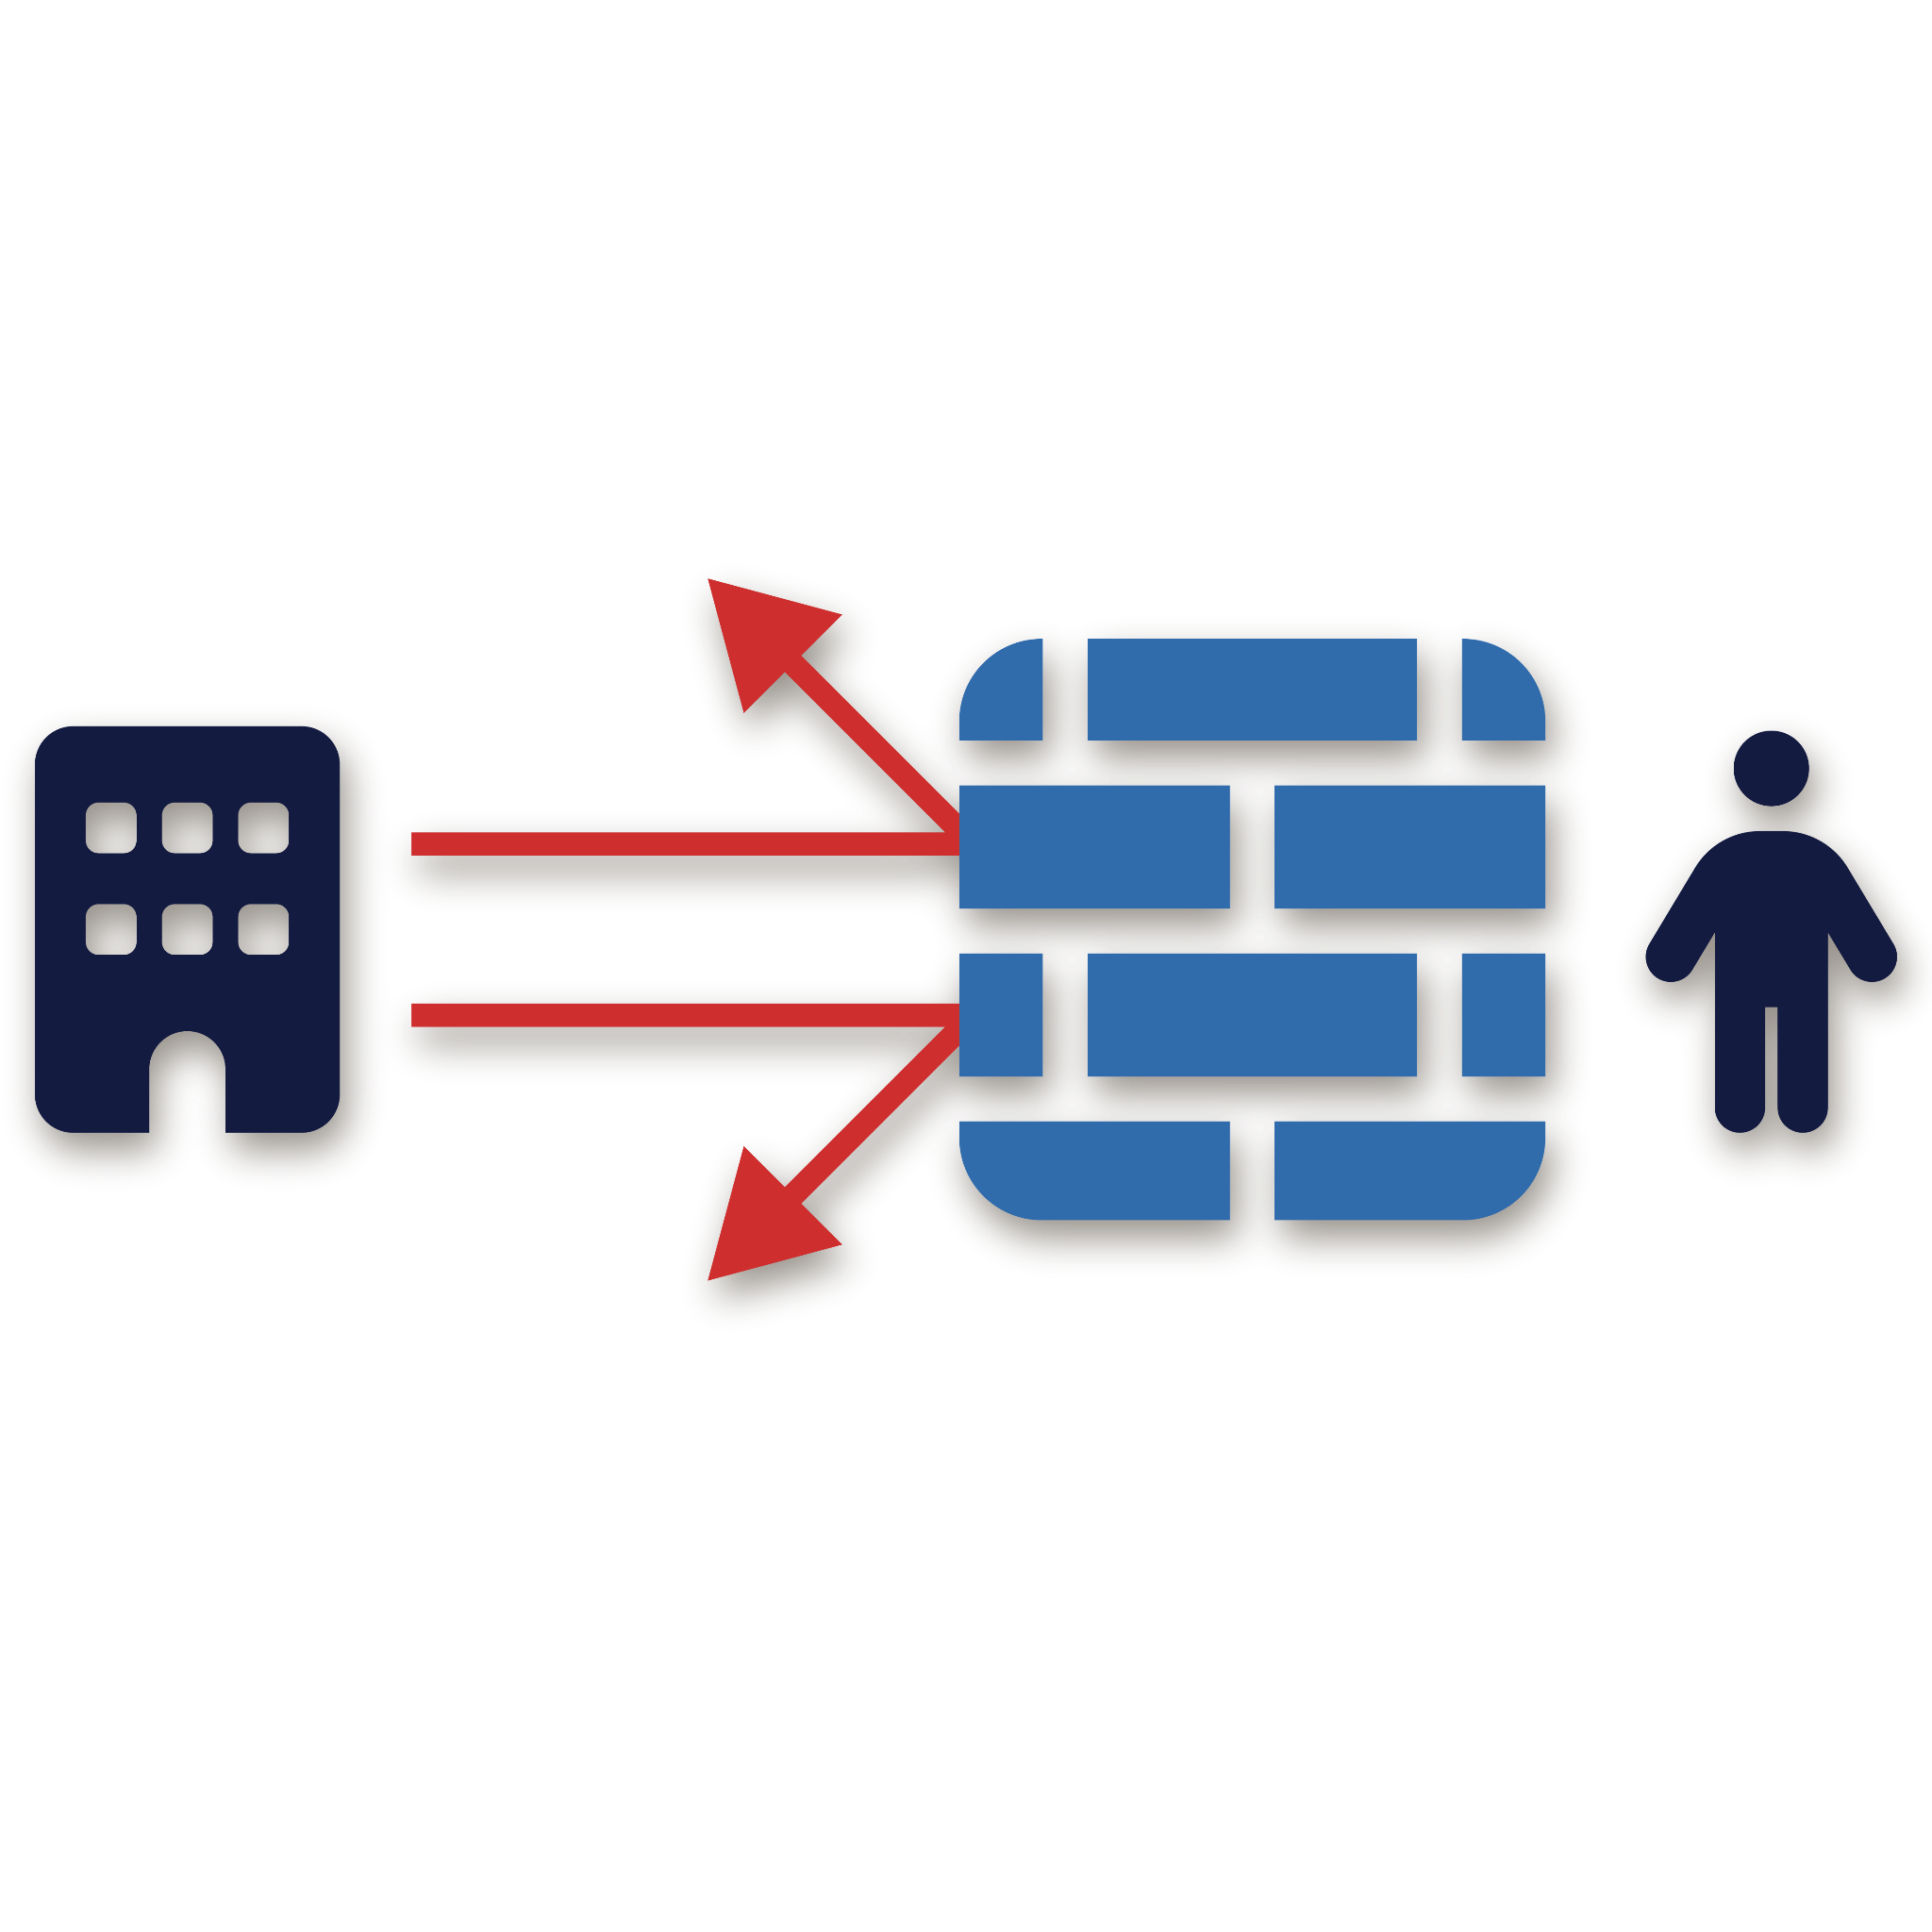
What is the Corporate Veil?
THE LEGAL SEPARATION BETWEEN YOU AND YOUR BUSINESS
Prevents creditors from reaching personal assets
Courts respect this separation ONLY when properly maintained
Corporate Veil

Slide 11

Corporate Veil Pricing
WHAT PUTS YOU AT RISK
Commingling personal & business funds
Undercapitalization (insufficient funds)
Missing or inadequate business records
Failing to follow corporate formalities

Slide 12
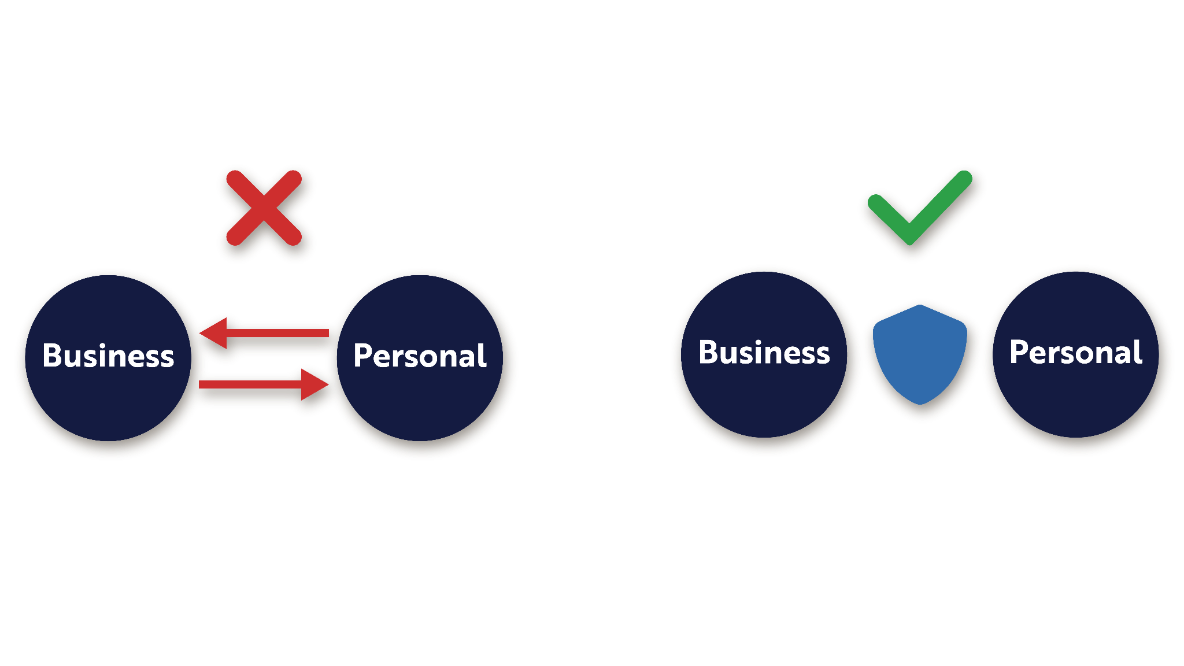
Fund Commingling
THE #1 THREAT TO YOUR ASSET PROTECTION
Courts may "pierce the veil" if funds are mixed
Commingling erases the legal separation you need
Separate accounts = stronger legal protection

Slide 13





File with the right state for your specific needs
Maintain proper business records
LLC Formation Best Practices
Create comprehensive operating agreement
Stay compliant with annual requirements
Open separate business bank accounts

Slide 14
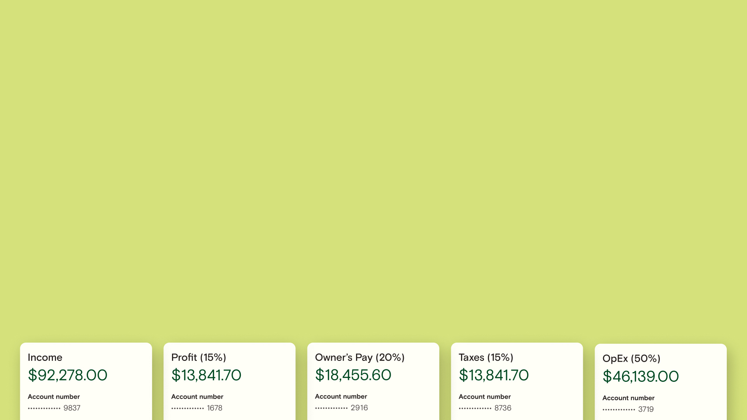


Separate accounts help maintain legal separation between personal and business finances
MULTIPLE ACCOUNTS
Stay in control: Know exactly how much money is allocated for expenses & savings
Keep financially stable: Avoid overspending, and ensure you’re ready for the unexpected!
Follow a Proven System: The Profit First method helps business owners build lasting profitability - a Profit First Professional can help you get started.
Documented separation strengthens liability protection
Notes:
Gain more understanding of where your money is going by using multiple accounts to separate your finances.
This allows you to:
Know exactly how much money is allocated for various expenses while still prioritizing saving for important things like taxes and company profits, giving you control over your finances.
Keep financially stable by avoiding overspending in areas you can’t actually afford, while will reduce your stress and ensure you’re prepared for upcoming expenses or even unexpected costs.
We’d suggest to follow a proven money management system to help you manage your money. The Profit First method has helped thousands of other business owners build a profitable, scalable business. If you’re interested, a Profit First Professional can help you get started, or, if you stay on, we’ll be offering a chance to win a free Profit First book at the end of this session!

Slide 15
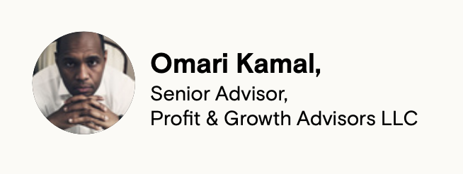
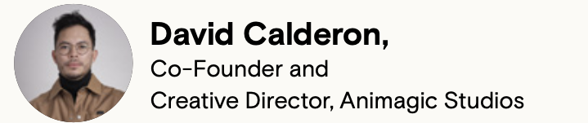
Separating accounts can lead to more cash flow clarity
“Small businesses need to be able to pull out their phones, click a couple buttons, and know that the money there can be used for operations, that it’s not needed for taxes, personal funds, or profits. Multiple accounts are absolutely critical to making decisions on the fly.”
“Every month we have financial reports, including what’s in each of the accounts and our projected payments. We’re trying to set up as many healthy habits as we can on the financial side so we can set the foundation for growth.”
Notes:
Many of our customers have found that the multiple accounts structure is a game-changer, for both small business owners and accountants & bookkeepers alike!

Slide 16
Separating accounts can lead to more cash flow clarity
MULTIPLE ACCOUNT TIPS
Connect your bank to your accounting software
Set up auto-transfer rules to separate your money into accounts for you
Find a banking solution that doesn’t charge account minimums or fees
Regular documentation of business purpose for transactions
Notes:
To make the most of the multiple account structure, make sure you:
Connect your bank to your accounting software - Relay has direct API integrations to various money money management systems like Xero or QuickBooks Online to allow automatic transaction syncing for easy tracking and reconciliation.
Don’t manually split your income into each account - that’s just painful. Instead, set up automatic transfers based on fixed amounts or percentages to distribute your funds easily. Whether you prefer daily, weekly, or monthly transfers, it’s all about what works best for your business.
And lastly, it’s super important to make sure that your bank isn’t going to be charging you to have multiple accounts. Many traditional banks charge you just to have multiple accounts or require high balance minimums - that’s money better spent growing your business. Make sure your bank supports a multiple accounts structure without extra costs or restrictions.

Slide 17

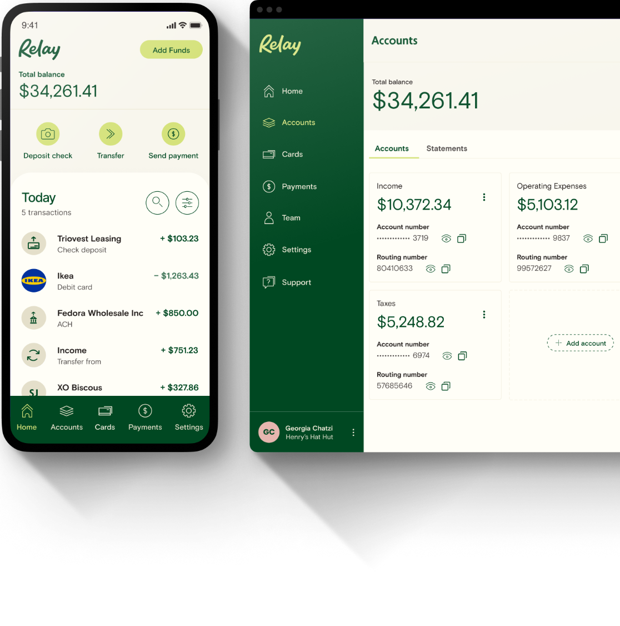
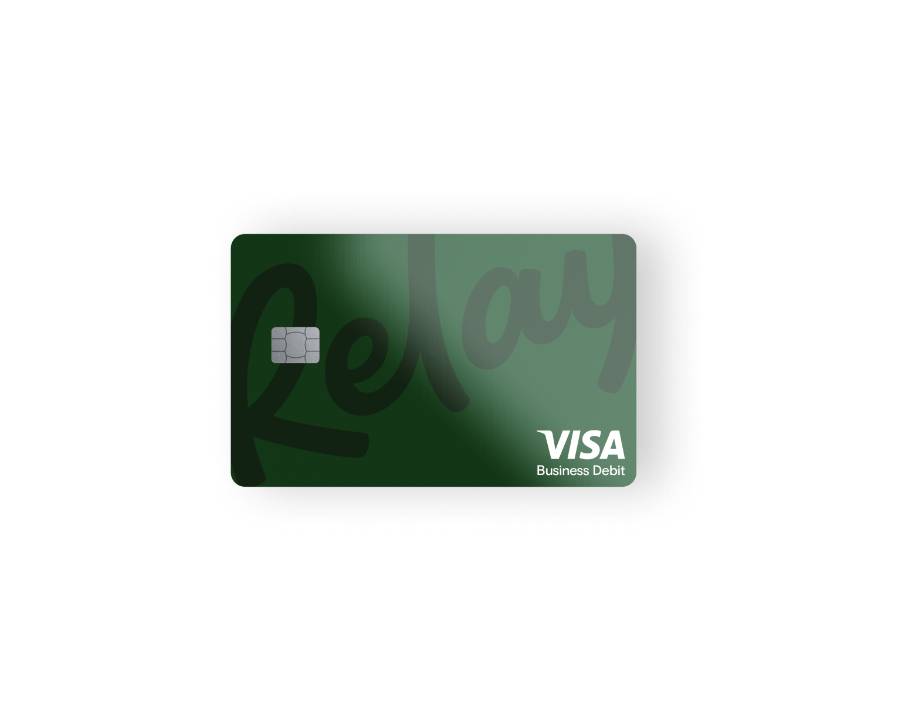
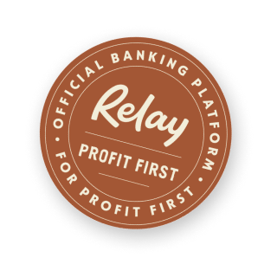
RELAY
DEEP DIVE
DEMO
Notes:
Stark Industries
Home page:
Available balance + total balance:
Small but mighty feature
Total balance is what we are used to seeing, it’s everything that’s been posted on your account.
Available balance:
Designed to help you a bit more.
Read out description
Really helpful tool for business owners.
Running balance:
Totalling your pending transactions
Point out pending vs. Posted below
Go over transaction details as well
Accounts:
Have more than the 5 recommended accounts, which is great to see.
A few tips:
Payroll:
Have an integration with Gusto. If you use Gusto to run your payroll, then you get a few more perks out of Relay. One of the most important is the insufficient funds warning.
If you don’t have enough, gives you a warning
Read warning
Click review warning
Ready out amount owed
Really helpful to stay ahead of those cash flow issues instead of waiting until the problem happens.
Profit First auto-transfer rules >Accounts> Move Money > auto-transfer
Explain flow of funds
Create auto transfer rule
Cards:
Card Switching tool:
Select travel expenses card from dashboard
Click start switching
Knot module will pop up, click continue
Select the vendors you want knot to update. They will update your card details on file so you can manage payments all in once place. This will make it so that it’s added as your primary card, aka it will not replace your card details or delete past card details.
Go to travel
Select American Airlines
Continue
Enter credentials
If you want to add more vendors in the future but the switching tool module has disappeared, you can click the three dots and select switch business purchases to this card.
Review: what cards are open on a regular basis
Freeze: If you have a card that was lost or stolen, you can actually freeze it yourself.
Set spend limits and withdrawal limits as well.
Virtual cards: can be great to set up per subscription.
Receipts:
Navigate to the Cards tab and select Receipts from the dropdown menu.
On the right-hand side, under Receipt policy settings, click Edit settings.
Go over receipt feature.
Expenses > Receipt Inbox
Cash at Relay:
Green Dot Network:
Customers were only able to deposit cash at AllPoint+ ATMs. With our new partnership with Green Dot, customers can deposit cash at over 90k retail locations including Walmart, Walgreens, CVS, 7-Eleven, and more. A fee will be charged by the retailer but will not exceed 4.95
You can still deposit cash at AllPoint+ ATMs for free.
Sweep program:
Up to 3 million
Payments:
W-9 feature
New Payment flow
Books by Bessie as Payee
Go through flow as normal
Go back to Payees > Run W9 Report
Team permissions:
Probably obvious that you are going to set up different access levels for your team. Go over team permissions and advisor permissions.
But what you might not know, is how to get your advisor on the board.
Integrations:
Settings page, point how to integrate
Settings > Add a business
Show how to set up second business under same log-in
Join the Profit Club now: https://relayfi.com/100k-profit-club
Leave us a review for a chance to win a copy of Profit First: Https://trustpilot.com/review/relayfi.com

Slide 18

Building Business Credit
A STRATEGIC APPROACH
Dun & Bradstreet (D&B) number to establish business credit identity
Privacy tradeoff: D&B information becomes publicly accessible
Think of your business like raising a child – initially dependent on your personal credit
Building business credit creates a financial firewall between personal and business finances
Strong business credit = better financing options

Slide 19
Next Steps
Notes:
What’s your business & how long have you been running it?
We work with so many different industries, professional services, salons, field service businesses, ecommerce, agencies, property managers, tech startups…. The list goes on and on!
So interesting to learn who we have on the webinar!
BANTER

Slide 20
Open my LLC
Open separate business banking accounts
Create/update my operating agreement
Schedule a consultation about my specific situation
Establish business credit separate from personal
Survey
After today's presentation, what step will you take first to strengthen your asset protection?
Notes:
What’s your business & how long have you been running it?
We work with so many different industries, professional services, salons, field service businesses, ecommerce, agencies, property managers, tech startups…. The list goes on and on!
So interesting to learn who we have on the webinar!
BANTER

Slide 21
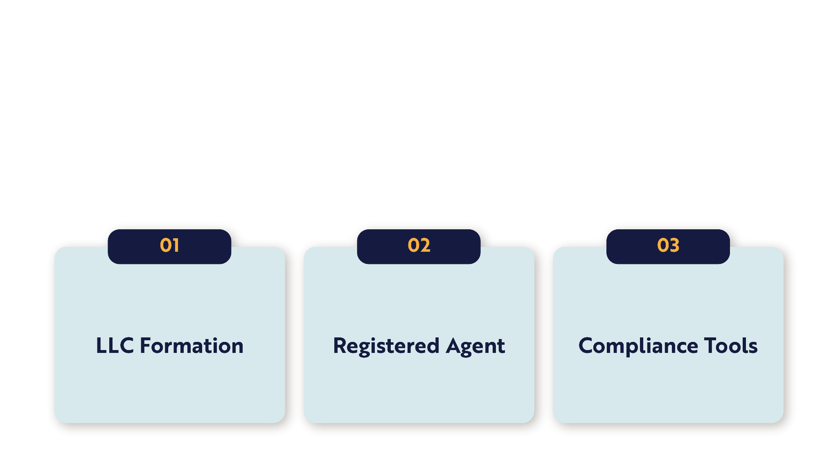

How We Can Help

Slide 22
24 Hour Filing
No Extra Charge for Privacy
How We’re Different
No Hidden Fees
Easy Bank Account

Slide 23


Our Pricing
FORMATIONS STARTING AT $49 + STATE FEES

Slide 24


50% off with code
WEBINAR50
Until Tomorrow!

Slide 25

EARN $50
WHEN YOU OPEN A NEW RELAY ACCOUNT AND FUND IT WITH $100*
*Conditions Apply
SIGN UP TODAY
Notes:
Finally, a special Relay offer, when you sign up with a new account on Relay and fund it with $100 (and maintain that balance for 30 days) we will deposit $50 into your account. On us! Drop link in chat: https://join.relayfi.com/promo/get-50-ulumkswykjzwi4dqsm?referralcode=CloudPeakLaw&utm_source=partnerships

Slide 26

Don’t Forget
We’d love your feedback! After the webinar, please fill out our quick Zoom survey - it’ll help us make future sessions even more valuable for business owners like you. Thanks for sharing your thoughts!
If you found this webinar helpful, feel free to share the link in the chat with any business owner who might benefit!

Slide 27
Q&A

Slide 28
THANK YOU
info@llcattorney.com
support@relayfi.com

