Slide 1


Slide 2

Housekeeping
45-minute presentation
Q&A at the end
Recording available afterwards
Use chat for questions

Slide 3

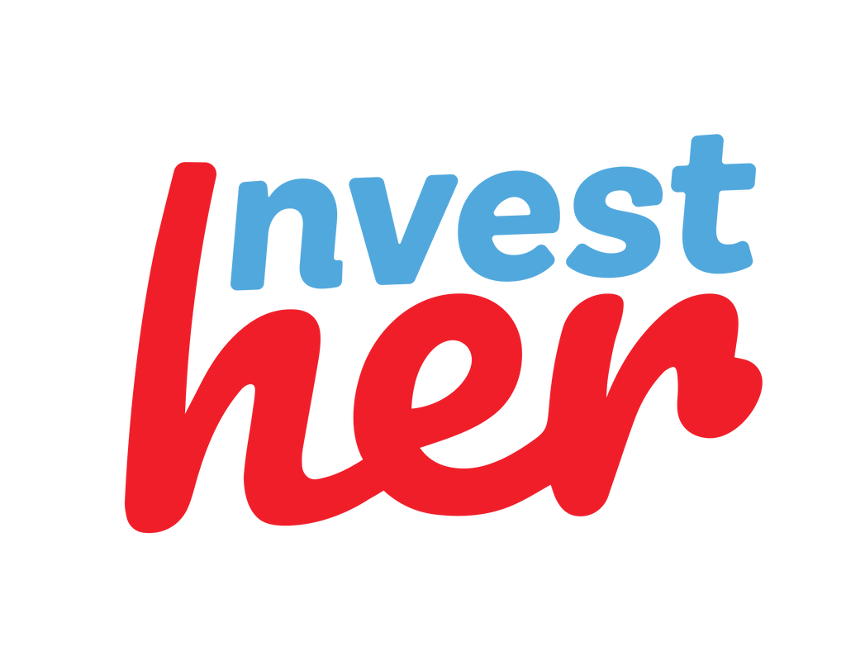
+
STRIVE
500
PODCAST
BUILD GENERATIONAL WEALTH
WITH CONFIDENCE
IN 42 COUNTRIES
+
16K
INVESTHER PLUS
MEMBERS
FB PRIVATE GROUP
MAKE DEEPER CONNECTIONS
AND GROW TOGETHER
16K
INVESTHER ASSESSMENT
IG FOLLOWERS
DETERMINE WHAT TYPE OF INVESTHER YOU ARE

Slide 4
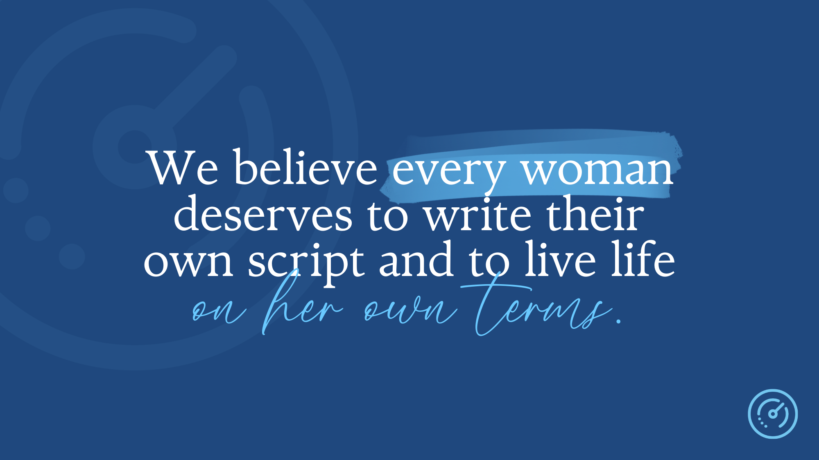

Slide 5
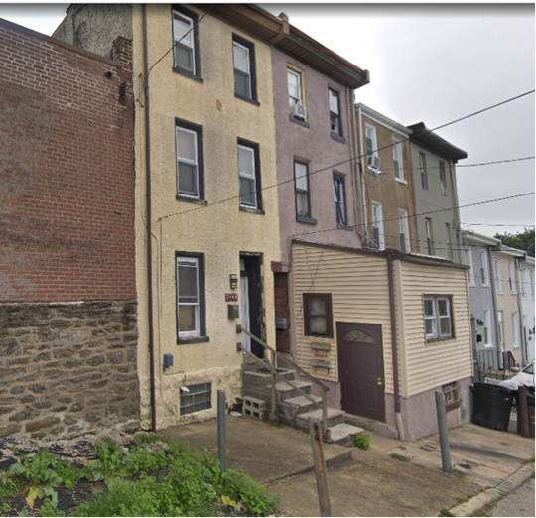
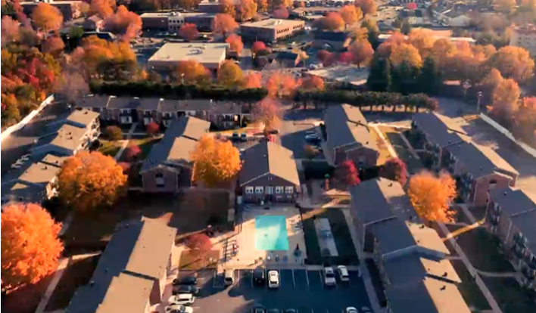

The Journey...
2 Units, PA
670 Units, NC & KY
$30,000
$60 million
Liz Faircloth | Co-Founder, RealEstateInvestHER
Notes:
Cool looking nice pretty logical path

Slide 6

The actual journey...
670 Units, NC & KY
$60 million
2 Units, PA
$30,000
Liz Faircloth | Co-Founder, RealEstateInvestHER
Notes:
IN REALITY - Graphic that shows a path ALL over the place

Slide 7

WHAT IS YOUR
BIGGEST FEAR
WHEN IT COMES TO SCALING YOUR PORTFOLIO?
Liz Faircloth | Co-Founder, RealEstateInvestHER

Slide 8

FAST Method
F – Focus
A – Analyze
S – Systems
T - Team

Slide 9

STEP #1: FOCUS

Slide 10

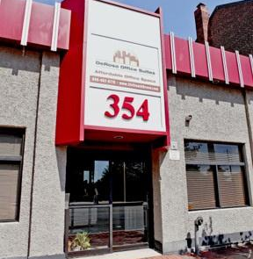
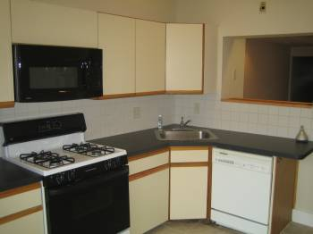
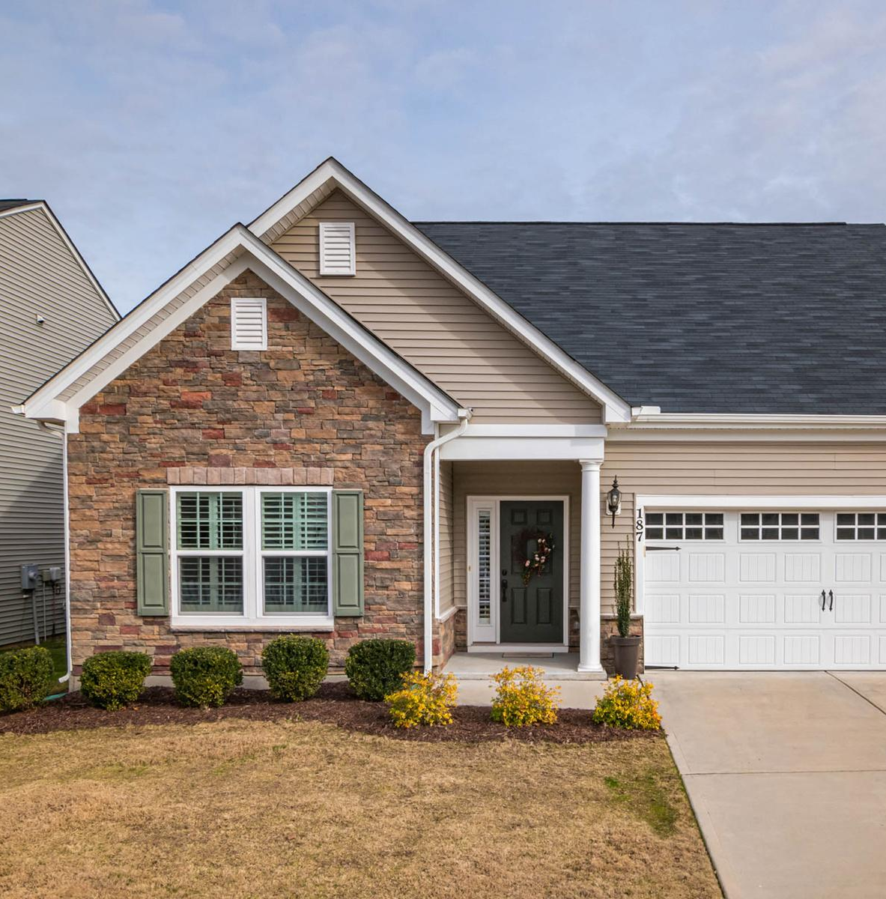

Liz Faircloth | Co-Founder, RealEstateInvestHER

Slide 11

REAL ESTATE IS 3 FOLD
MARKET NICHE
REAL ESTATE ASSET CLASS
STRATEGY
Liz Faircloth | Co-Founder, RealEstateInvestHER

Slide 12


Matching Legal Structure to Portfolio Risk
Jonathan Feniak | Lead Attorney, LLCAttorney.com

Slide 13

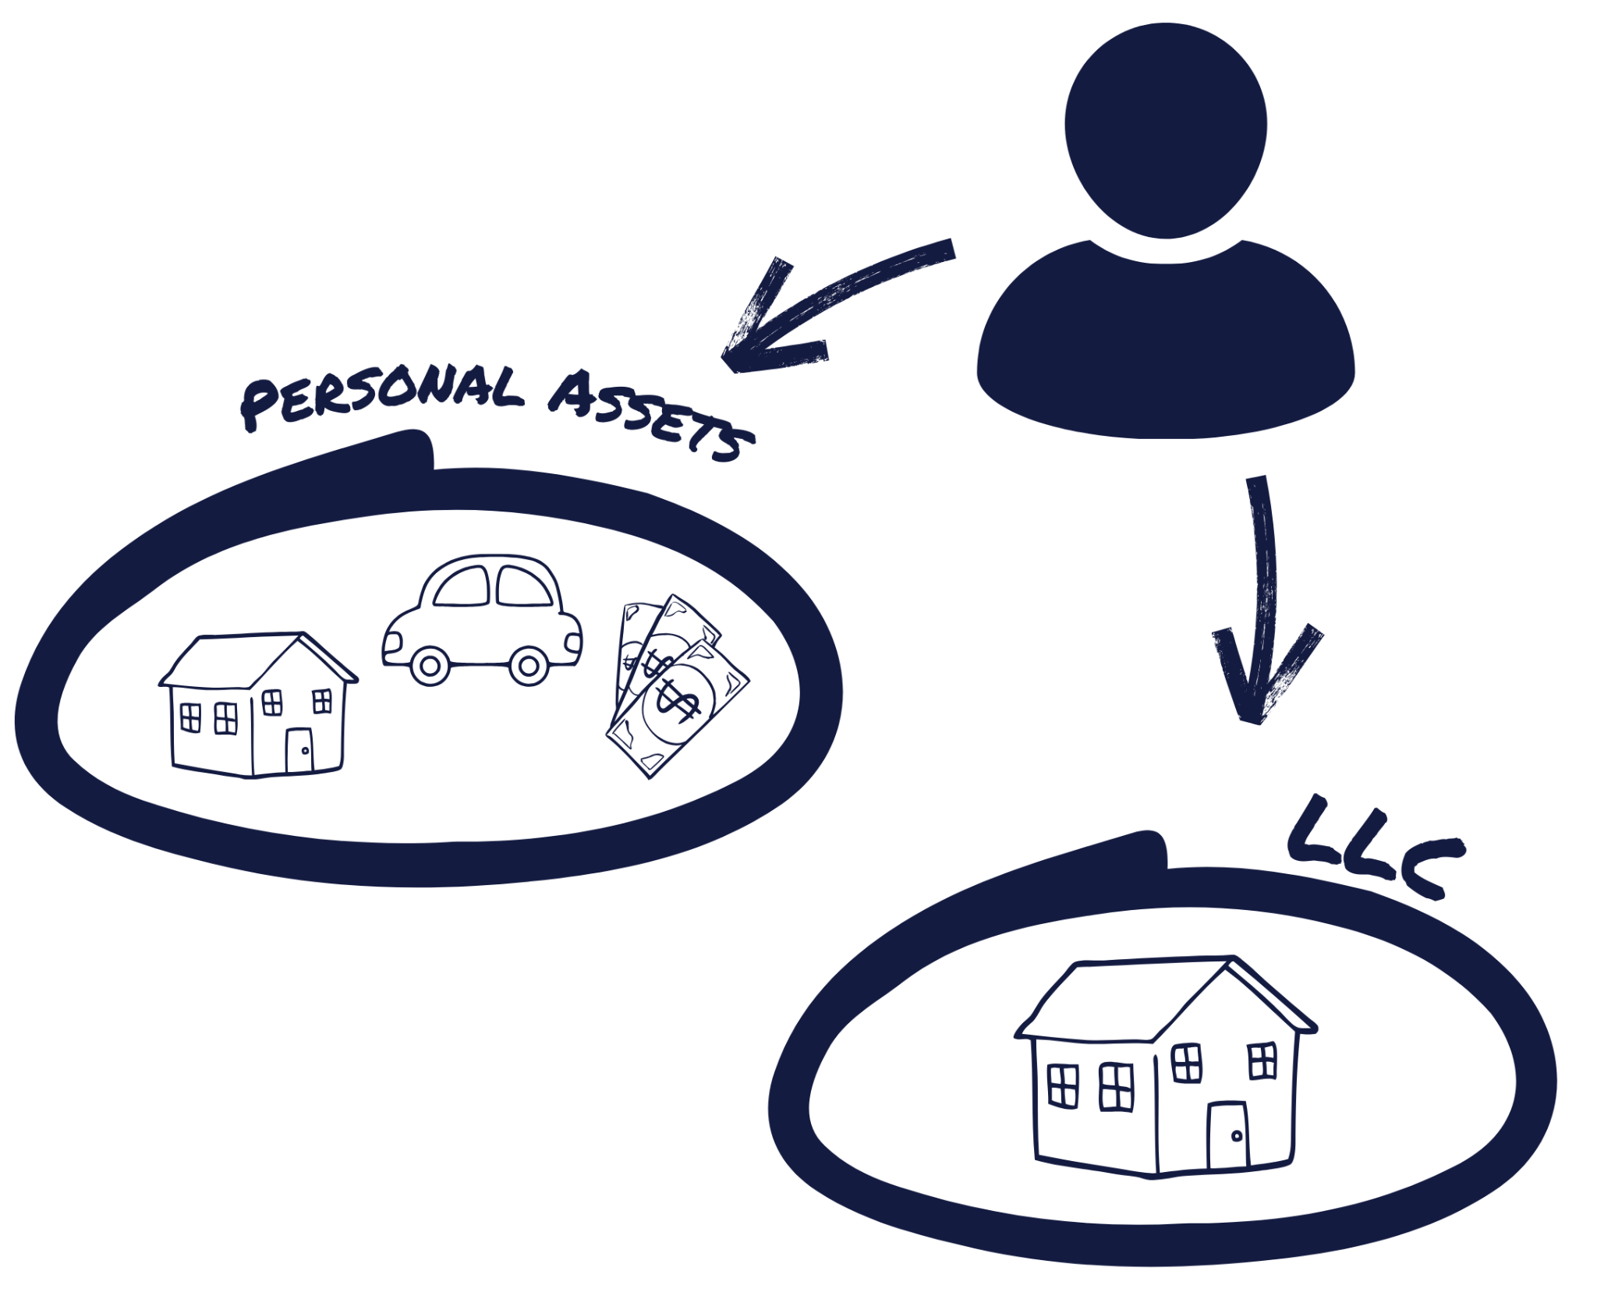

Starting Simple
Single Property LLC
Start with what you need
Basic protection is often sufficient for first 1-2 properties
Three key benefits:
Separation assets
Clear accounting boundaries
Basic liability shield
Jonathan Feniak | Lead Attorney, LLCAttorney.com

Slide 14




State Selection
Wyoming, Delaware, New Mexico, vs Your Home State
What is “Doing Business”?
Administrative & Cost Burden vs. Your Risk

Slide 15
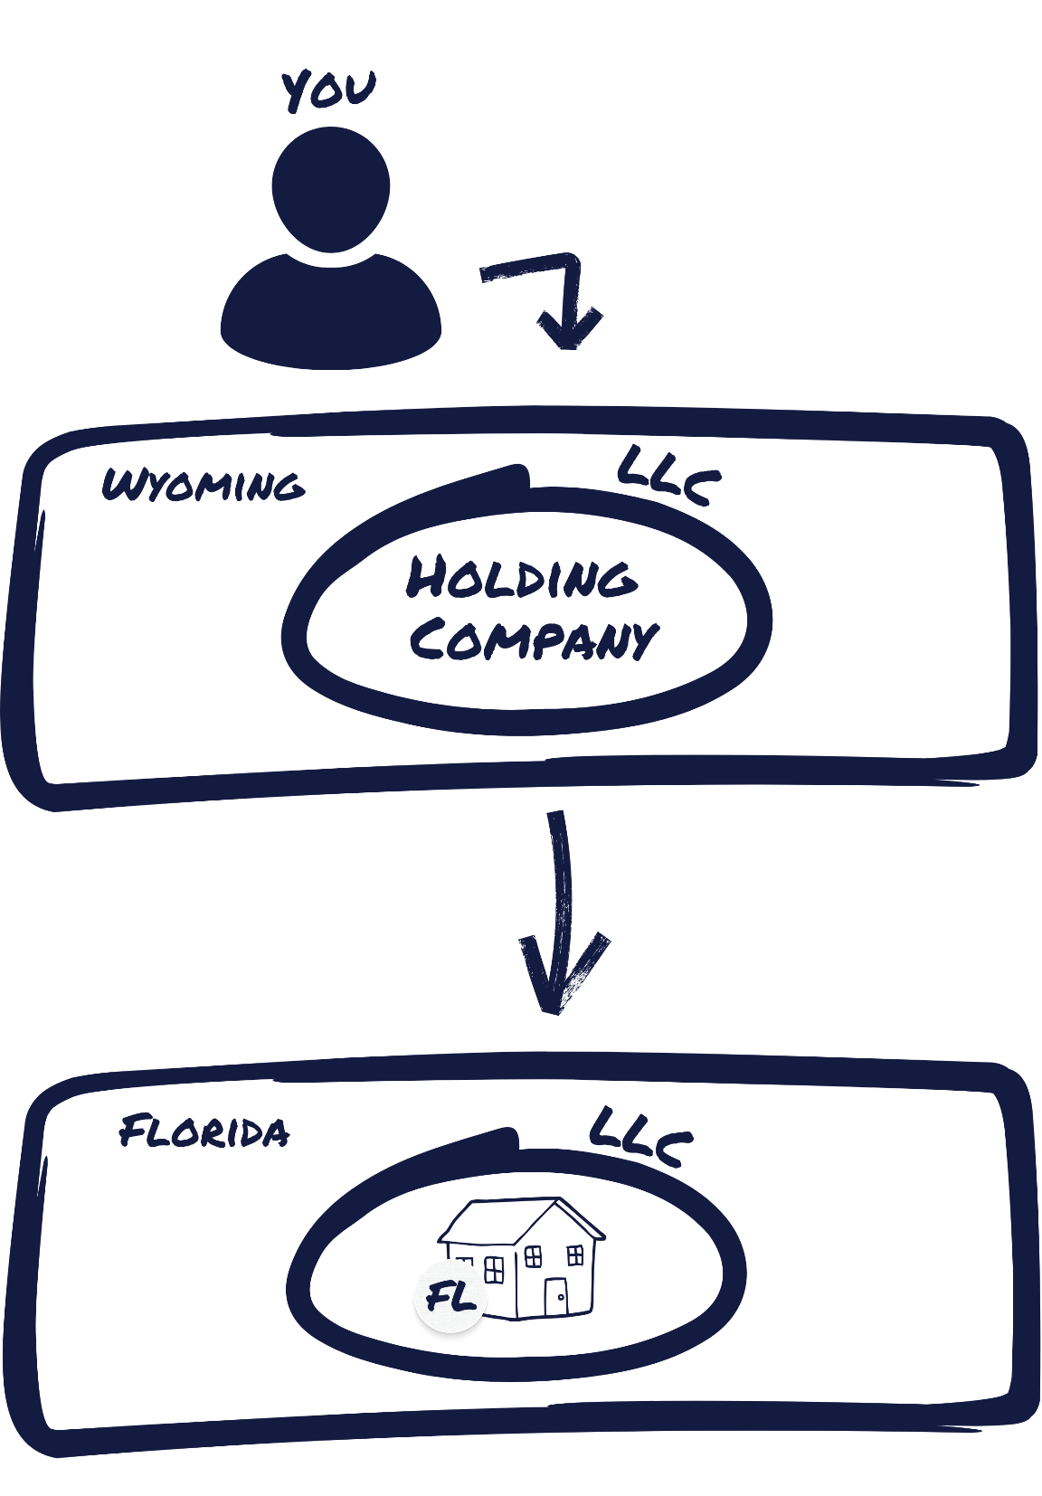
Wyoming Holding
Company Evolution
Trigger points for upgrading:
3+ properties
Partnerships
Multi-State Portfolios
Privacy concerns
Increased liability exposure
Jonathan Feniak | Lead Attorney, LLCAttorney.com

Slide 16



A – Analyze

Slide 17


#1 MARKET > DEAL
Liz Faircloth | Co-Founder, RealEstateInvestHER

Slide 18

WHY MARKET FOCUS?
Easier to scale (brokers, property management)
Leverage
  Maintenance
  Management
  Money
Local Business Collaboration
Liz Faircloth | Co-Founder, RealEstateInvestHER

Slide 19
Population Growth
Employment Growth & Diversity
Economic Drivers
Supply and Demand Dynamics
Affordability
Local Real Estate Regulations and Taxes
Rental Income by Property and Unit Type
Solve housing challenges
MARKET ANALYSIS
Liz Faircloth | Co-Founder, RealEstateInvestHER

Slide 20
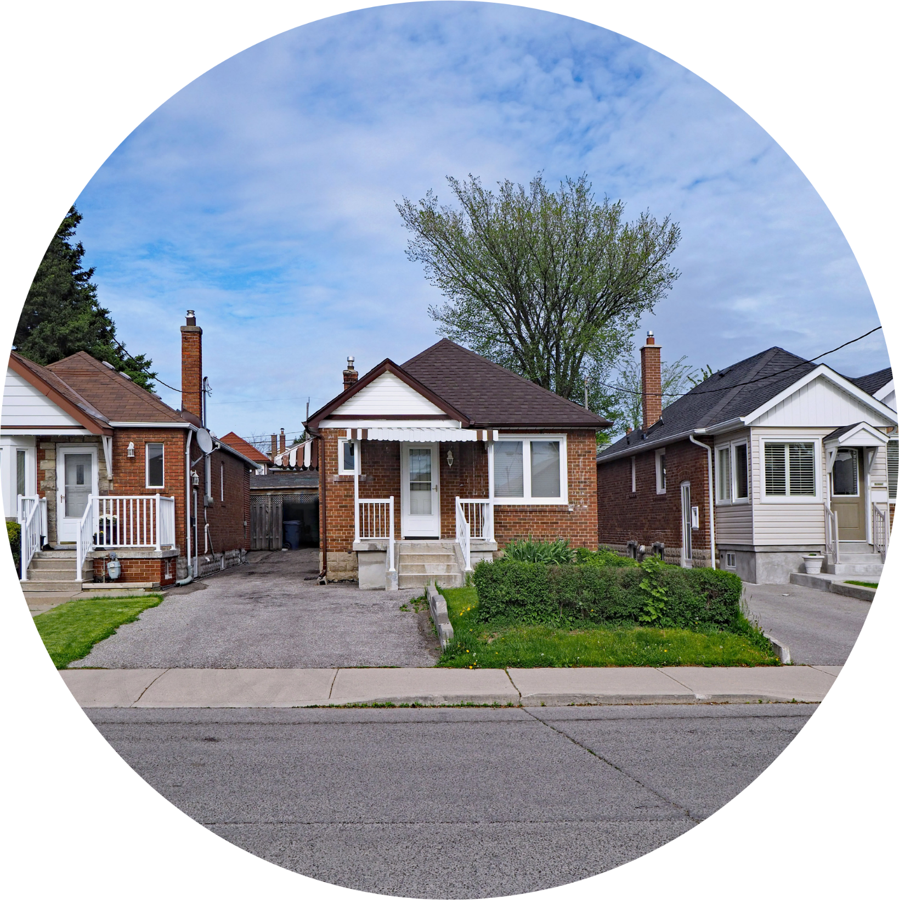



Property-Specific Risk
Analysis
Section 8
Luxury
Flooding
Earthquakes
Jonathan Feniak | Lead Attorney, LLCAttorney.com

Slide 21


Insurance
Your First Line of Defense

Slide 22

S Systems & Processes

Slide 23

  Creating Documented Processes/Work Flows
    Standard Operating Procedures (SOP)
      Automate ?
      Delegate ?
      Outsource ?

Slide 24

BUSINESS MONEY MANAGEMENT
SYSTEMS IN PLACE
TEAM
INVESTOR PORTAL
QUICKBOOKS
CFO/BOOKKEEPER
Liz Faircloth | Co-Founder, RealEstateInvestHER

Slide 25



Corporate Formalities
Annual meeting requirements
Documentation best practices
Record keeping systems
Jonathan Feniak | Lead Attorney, LLCAttorney.com

Slide 26

Management
Company

Slide 27

Contract Systems
Standard agreement templates
Review procedures
Storage and accessibility
Update protocols
Jonathan Feniak | Lead Attorney, LLCAttorney.com

Slide 28



TEAM
Liz Faircloth | Co-Founder, RealEstateInvestHER

Slide 29

THE FOUR SEATS ON THE BUS
Liz Faircloth | Co-Founder, RealEstateInvestHER

Slide 30
ADEQUATE
GOOD
GREAT
KNOW THYSELF
CORE
GENIUS
GREAT
GOOD
ADEQUATE
Liz Faircloth | Co-Founder, RealEstateInvestHER

Slide 31
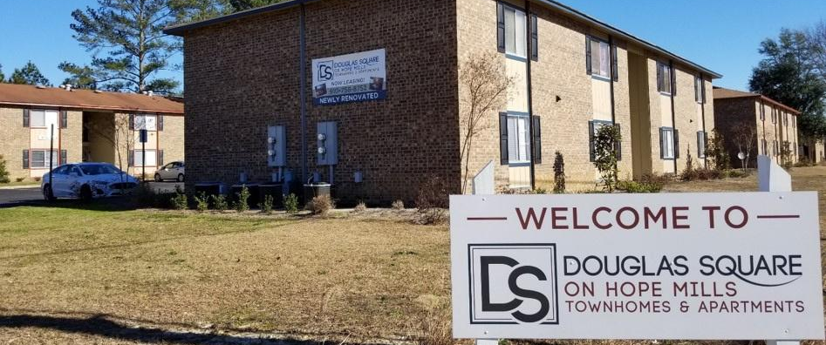
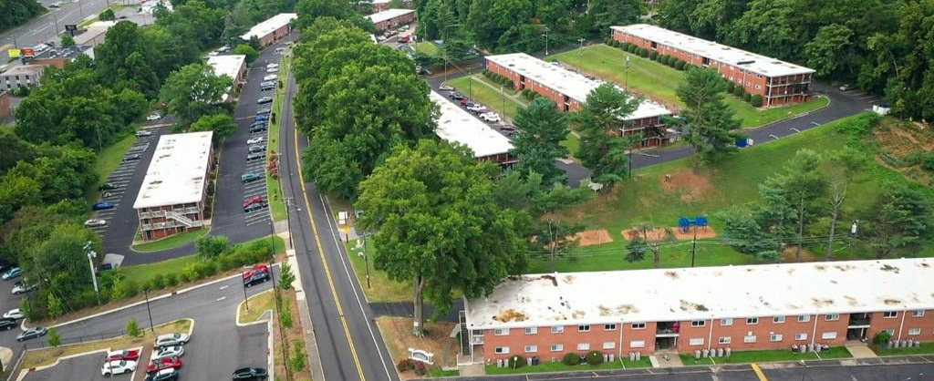
3 STEPS TO TAKE
01
BEHAVIORAL STRENGTHS
DISC, Predictive Index, Strengths Finder
02
CONATIVE STRENGTHS
YOUR INSTINCTS / HOW YOU EXECUTE - KOLBE INDEX
03
LEADERSHIP STRENGTHS
VISIONARY VS INTEGRATOR – ROCKET FUEL
Liz Faircloth | Co-Founder, RealEstateInvestHER

Slide 32
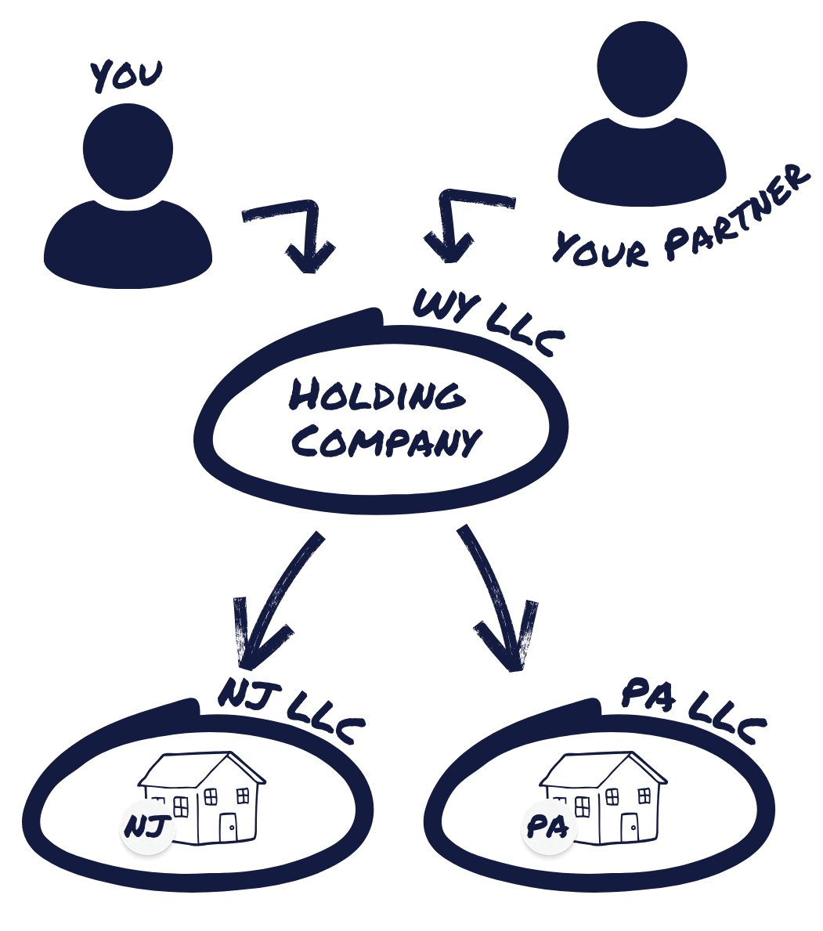
Partnership
Structures
Operating agreement essentials
Capital contribution structures
Decision-making authority
Jonathan Feniak | Lead Attorney, LLCAttorney.com

Slide 33

Employee/Contractor
Management
Compliance requirements
Training documentation
Risk mitigation strategies
Jonathan Feniak | Lead Attorney, LLCAttorney.com

Slide 34
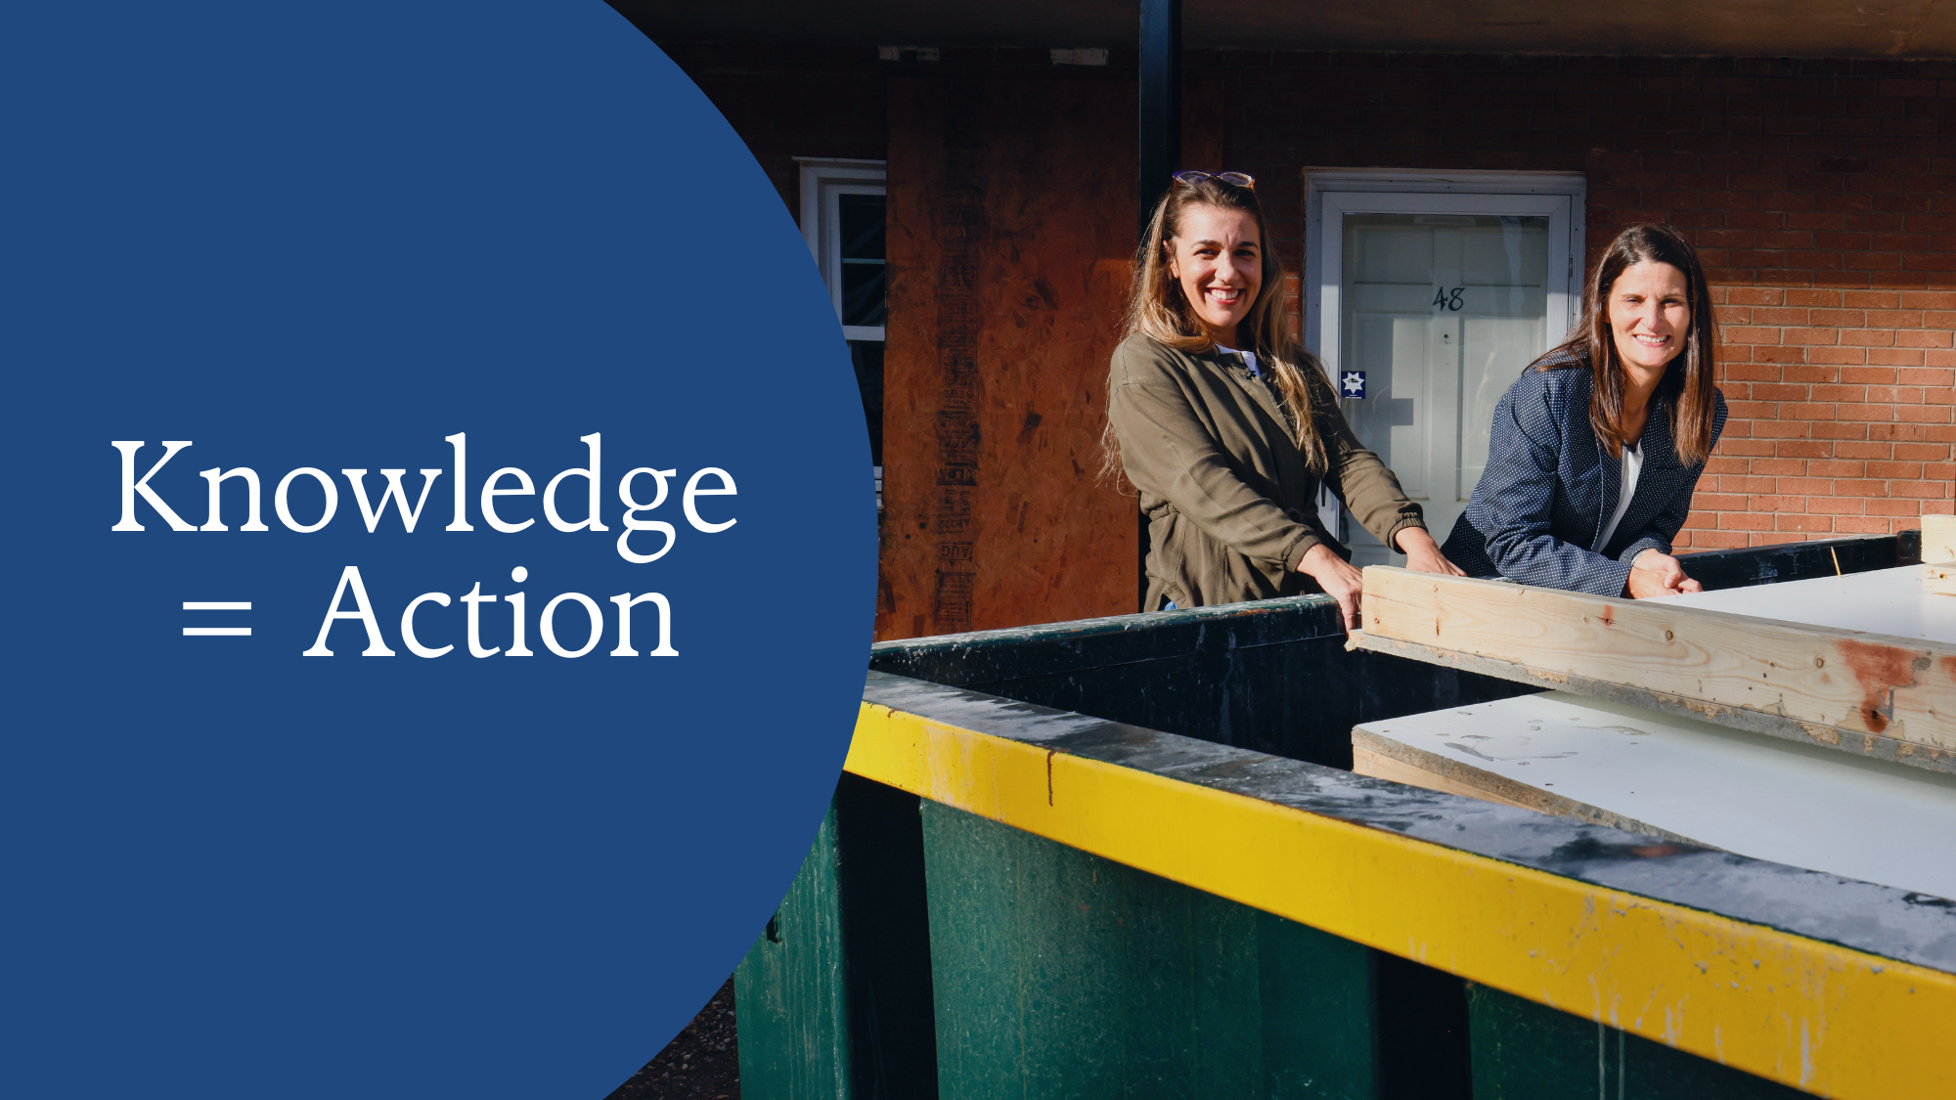

Slide 35


Slide 36

Scan to Access the Market Analysis Tool

Slide 37



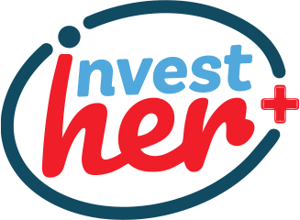









A one-stop platform for Deeper
CONNECTIONS
AND WEALTH BUILDING

Slide 38












ALL IN ONE-STOP
PLATFORM
VALUE OVER
$10,000
AI-Powered
Connections
Market
MastHER
E-book
On Demand:
Real Estate
Fundamentals
Nationwide
Chapters
27 YEARS OF EXPERIENCE
ON DEMAND: 10 EXPERTS
500 + PODCAST INTERVIEWS
COMMUNITY
Tailored
Podcast
Content
21 Day
Meditation
Guide
Exclusive
Perks &
Discounts!
InvestHER
Support

Slide 39



Make 2025 the year
you say YES to
Deeper Connections and
Wealth Building!
JOIN TODAY
FOUNDER’S PRICE $185
https://plus.investhercommunity.com/
ANNUAL INVESTMENT
50 PER DAY

Slide 40

How We Can Help
LLC formation
Registered agent
Compliance Tools

Slide 41
How We’re Different
24 Hour Filing
No Extra Charge for Privacy
No Hidden Fees

Slide 42

Our Pricing
Formations Starting at $49 + State Fees

Slide 43



30% off with code REALESTATE30

